Slide 1
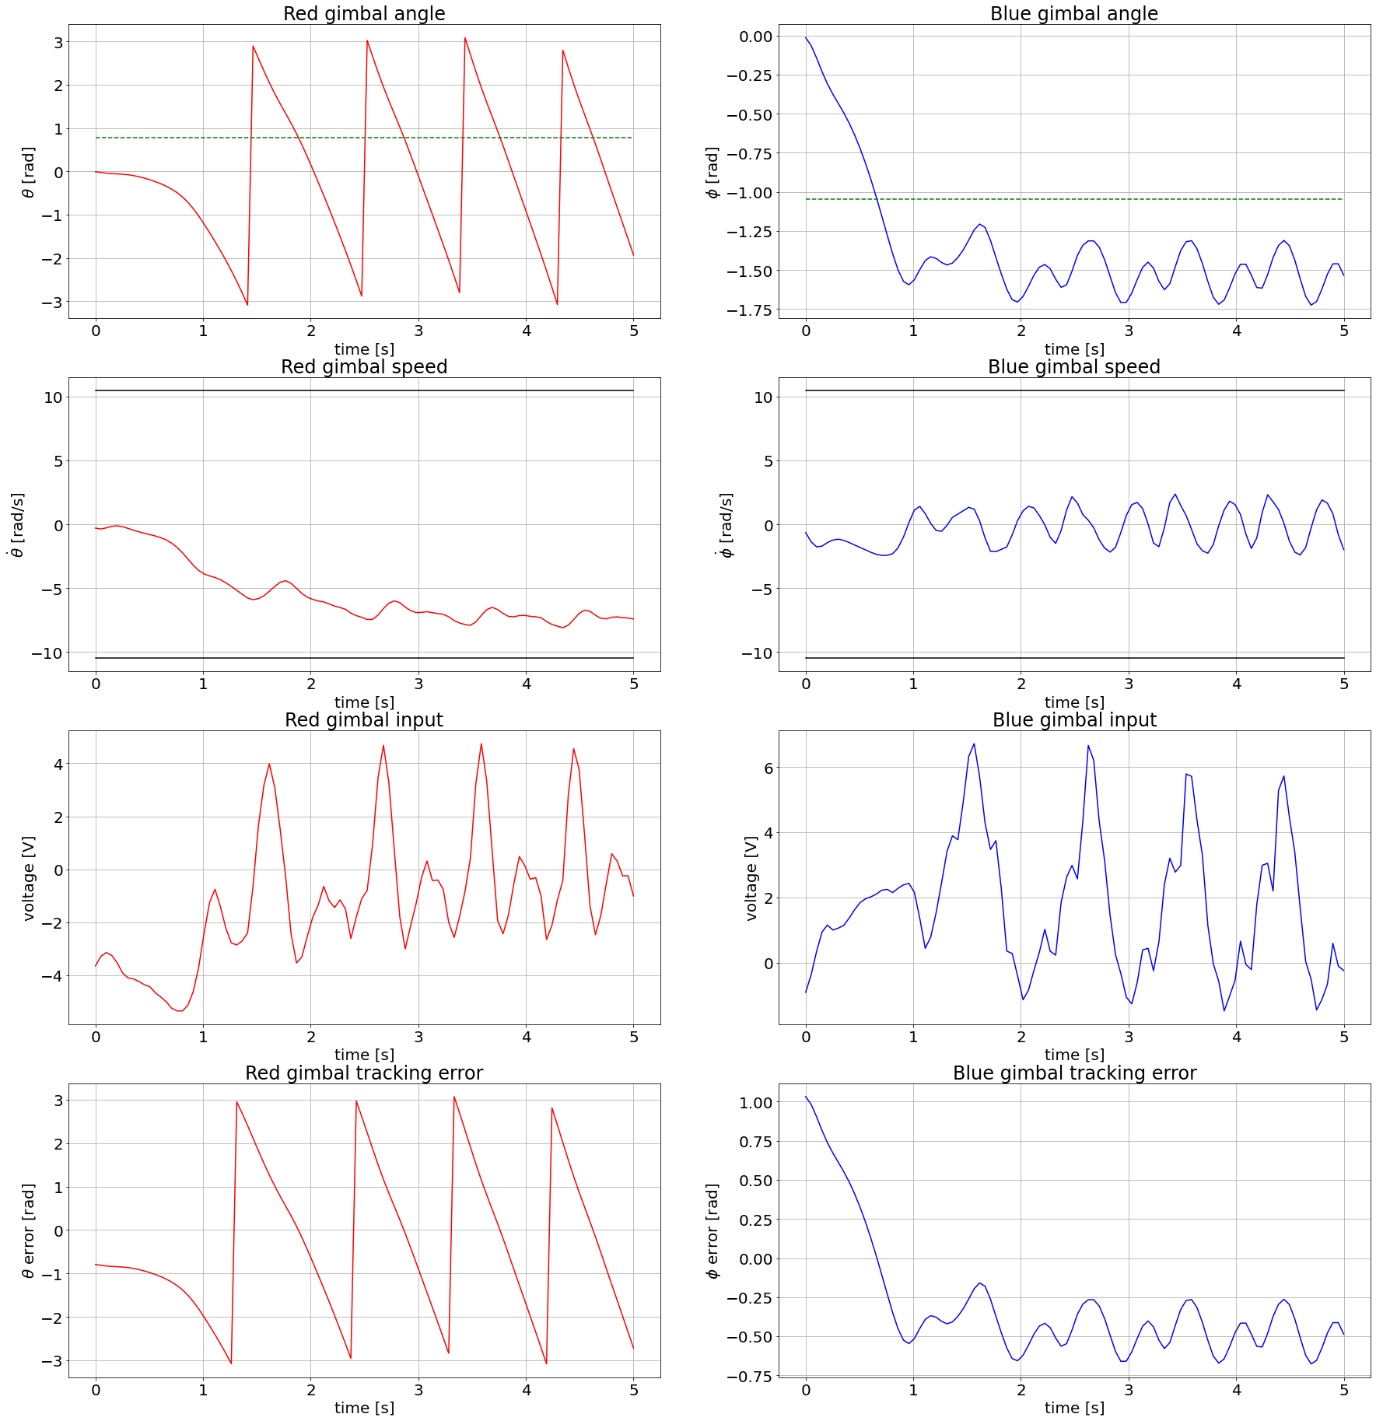
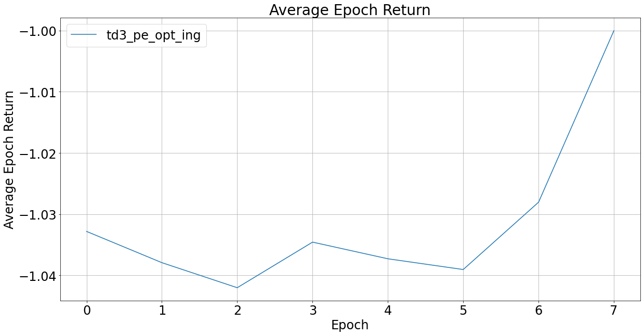
reward_func = 'PE'
def power_exp_reward(self, x1_diff, x3_diff, x2, x4, dx2, dx4, u1, u2, qx1 = 1, qx2 = 1, qx3 = 1, qx4 = 1, pu1 = 0, pu2 = 0, p = 0.1, e = 10):
TD3

Slide 3
TD3

Slide 4
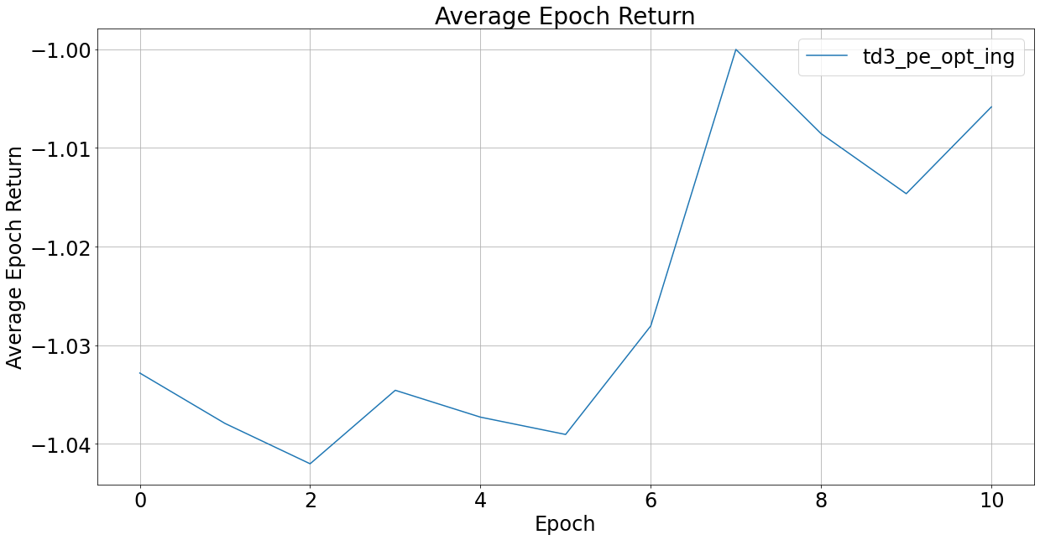
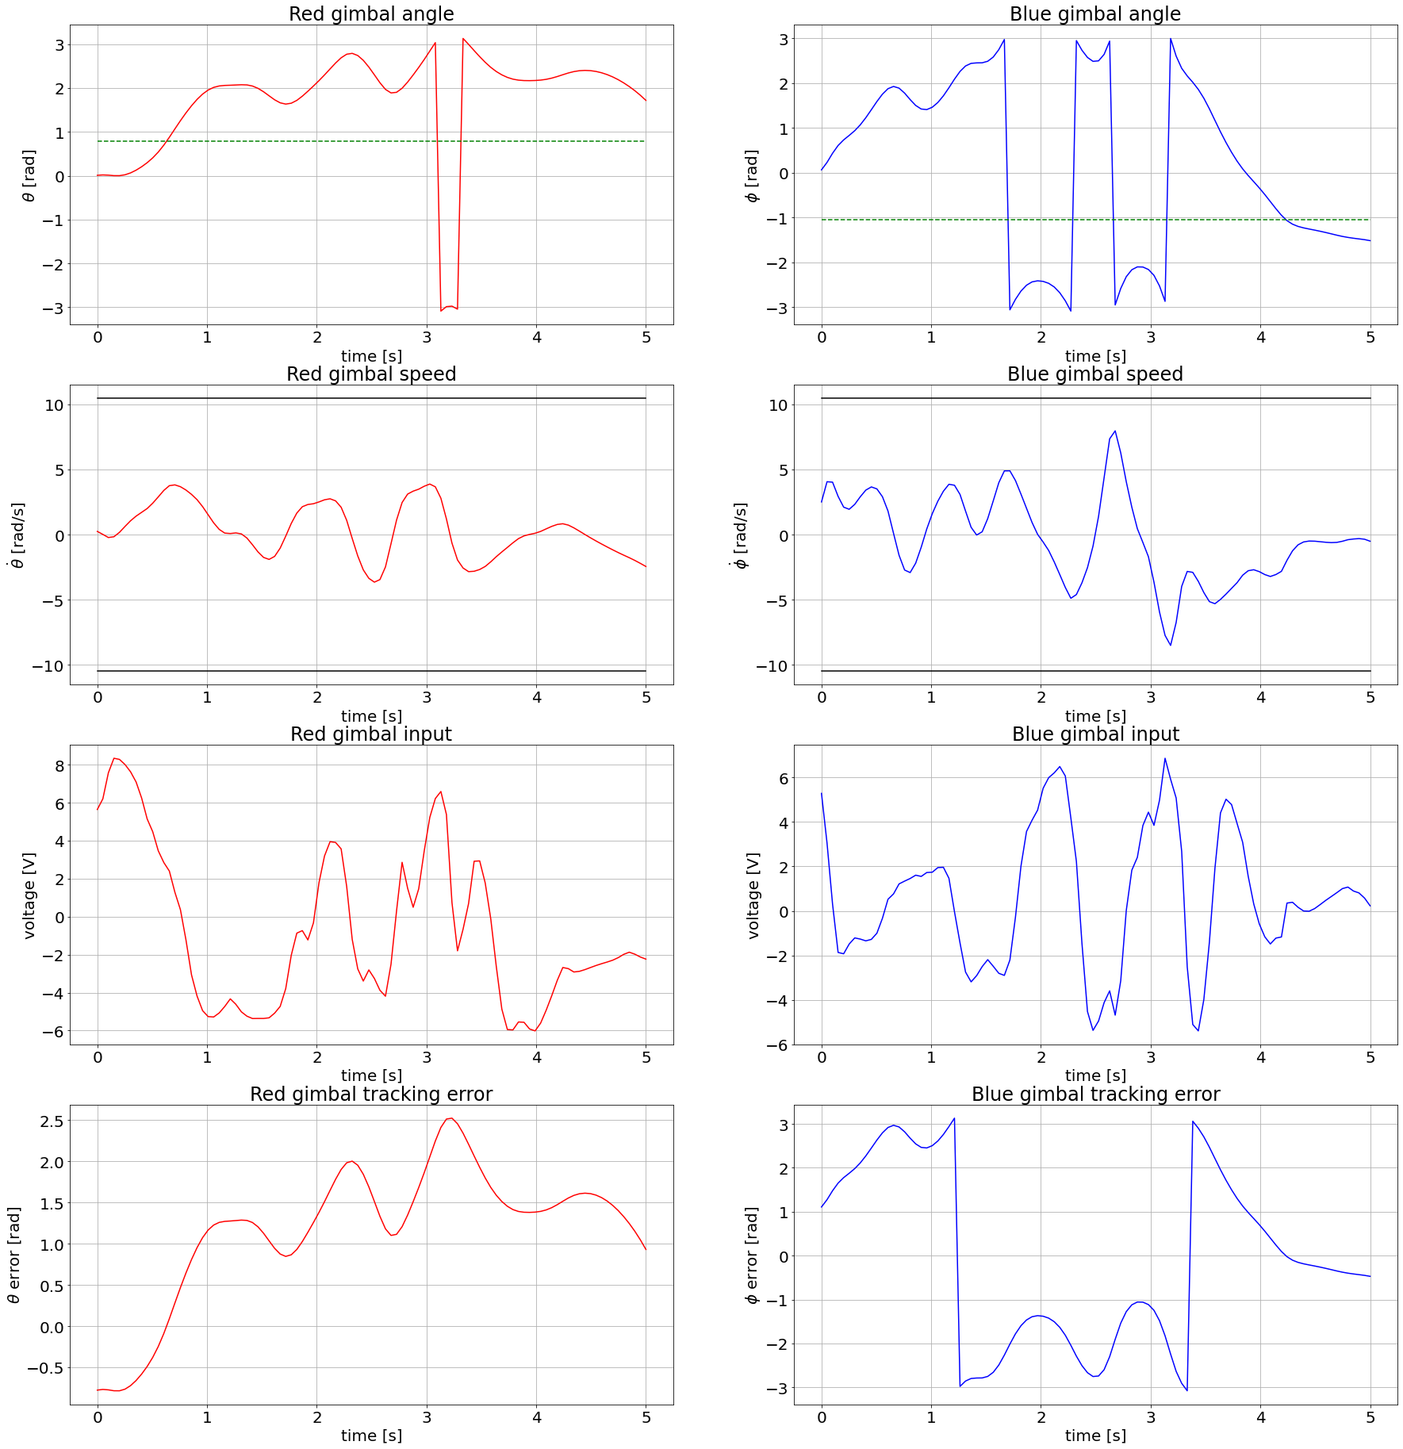
TD3

Slide 5
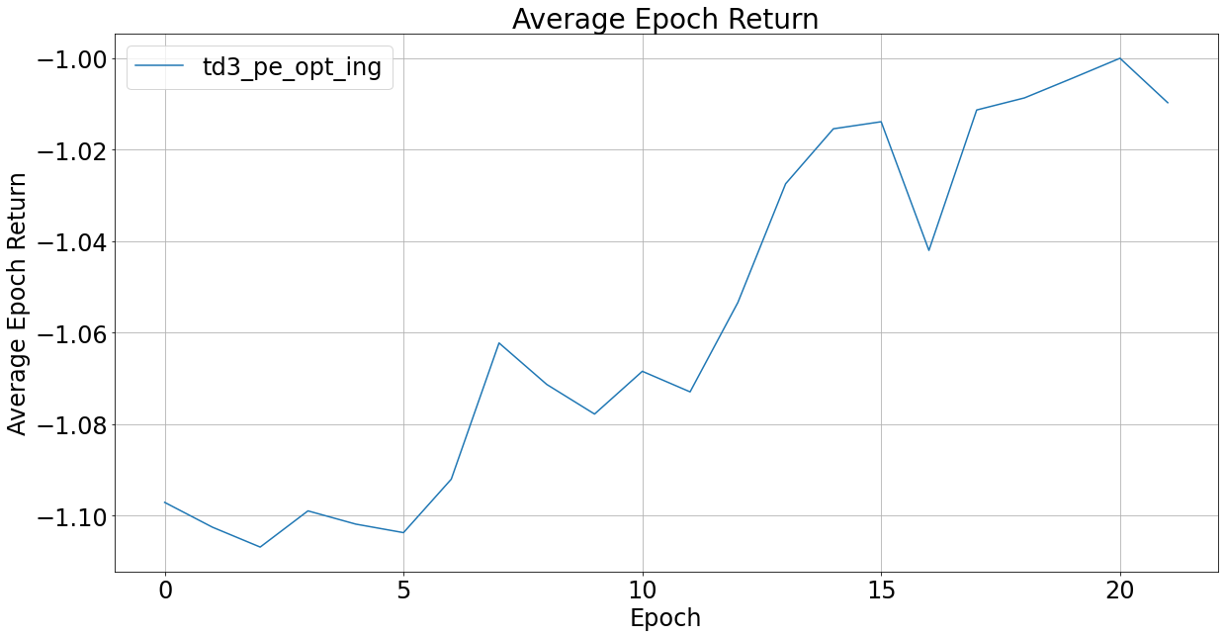
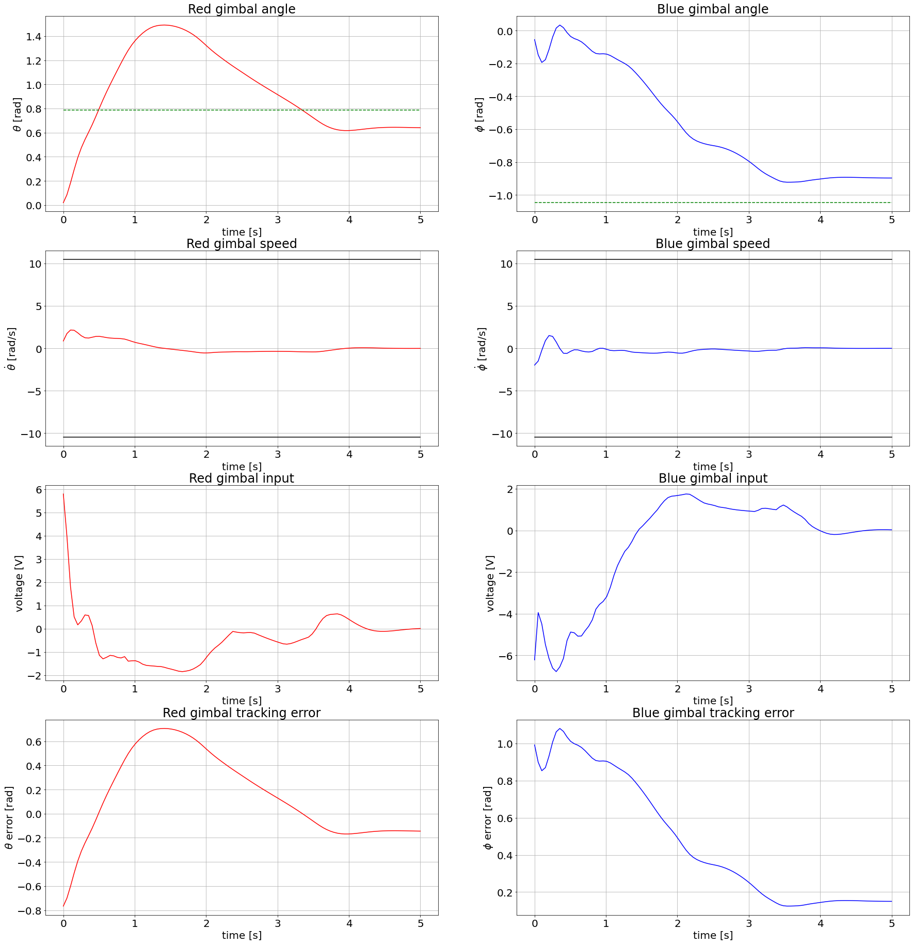
TD3

Slide 6

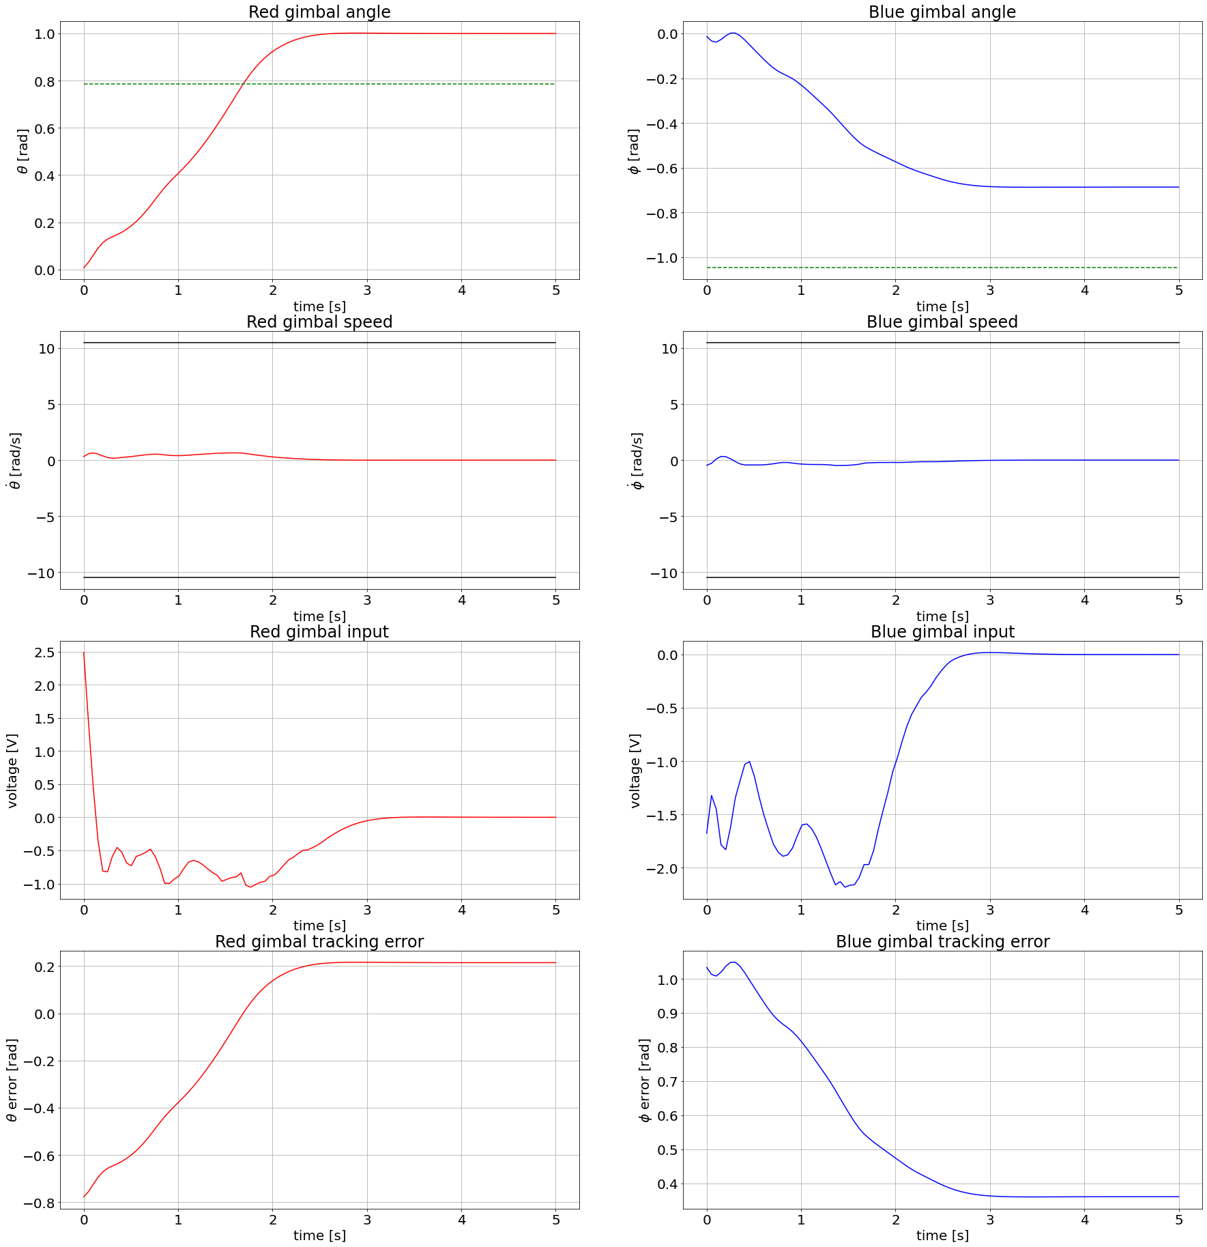
TD3

Slide 7
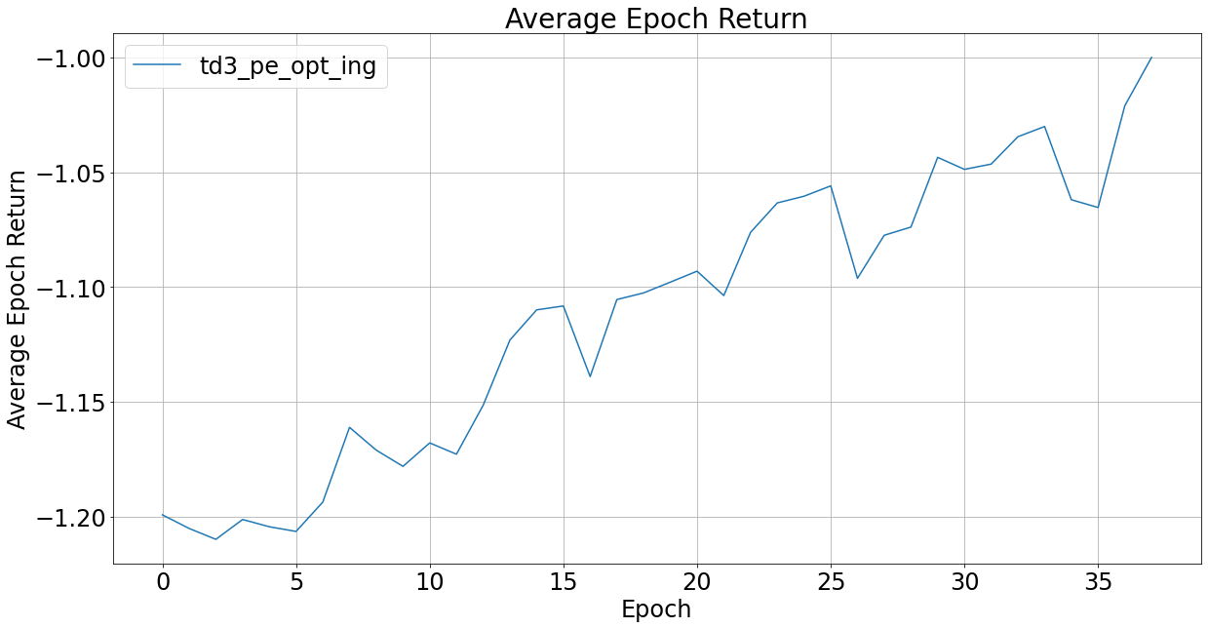
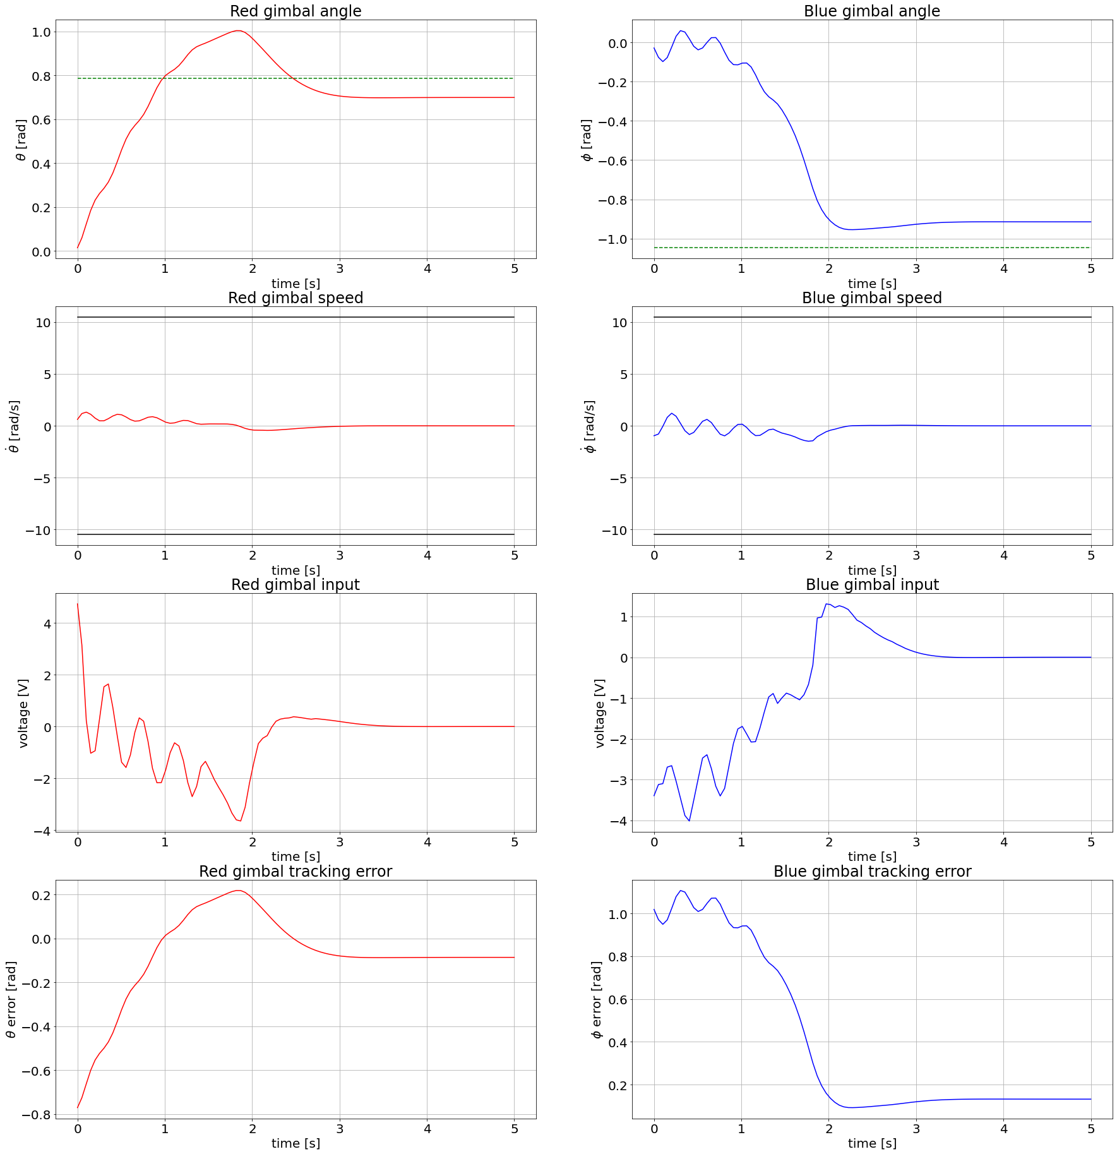
TD3

Slide 8
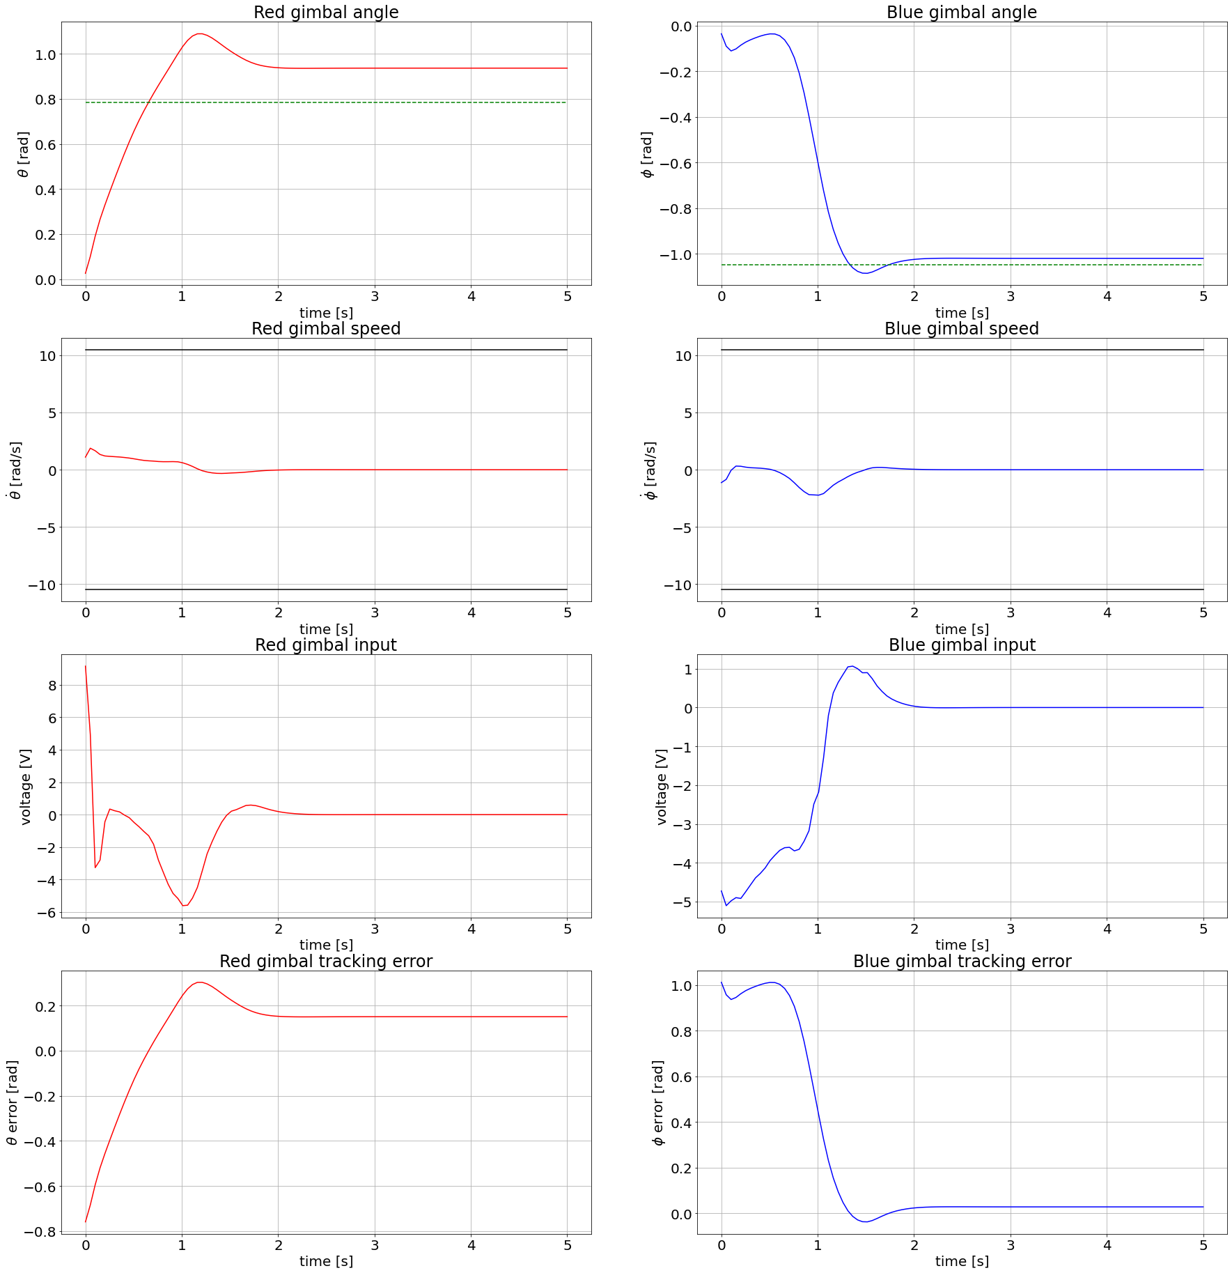
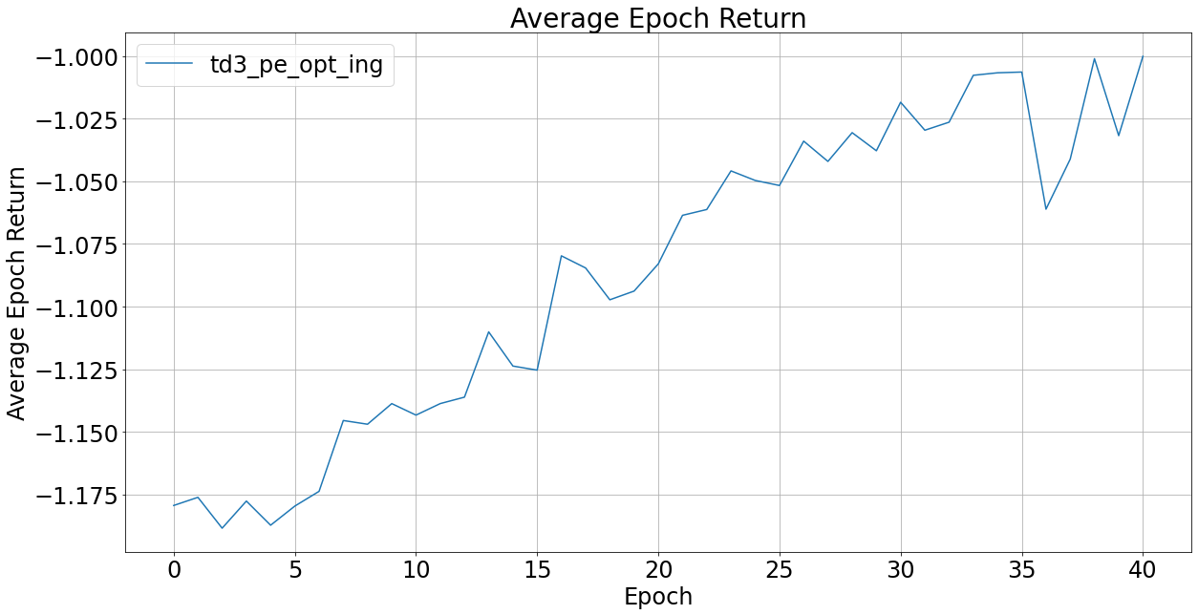
TD3

Slide 9
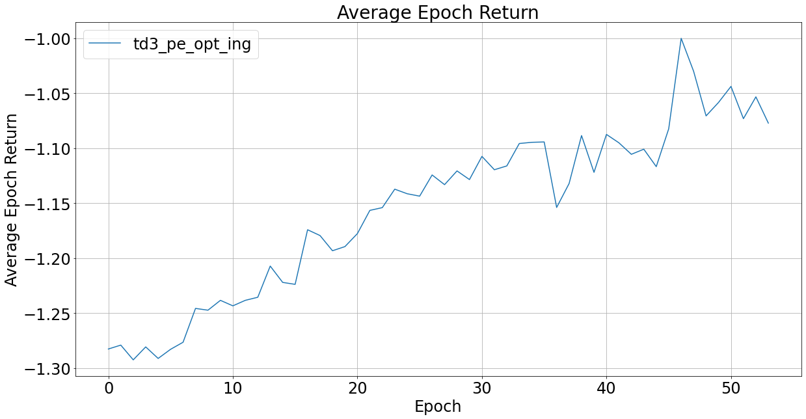
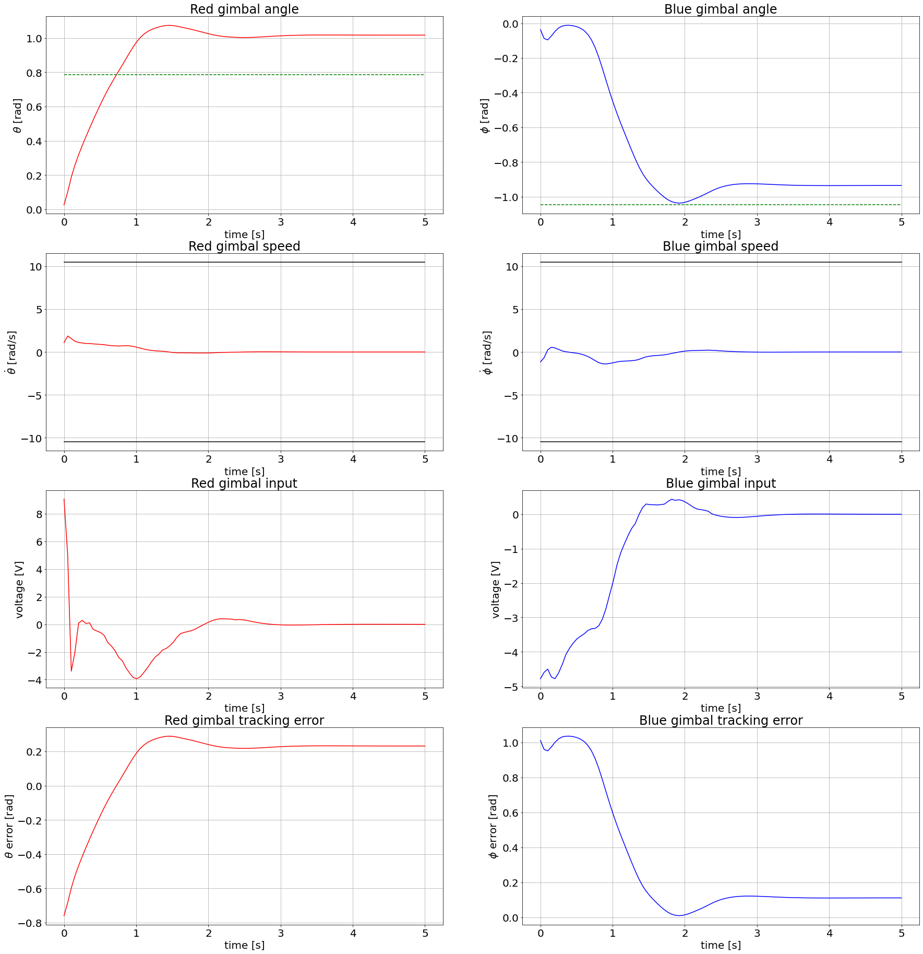
TD3

Slide 10
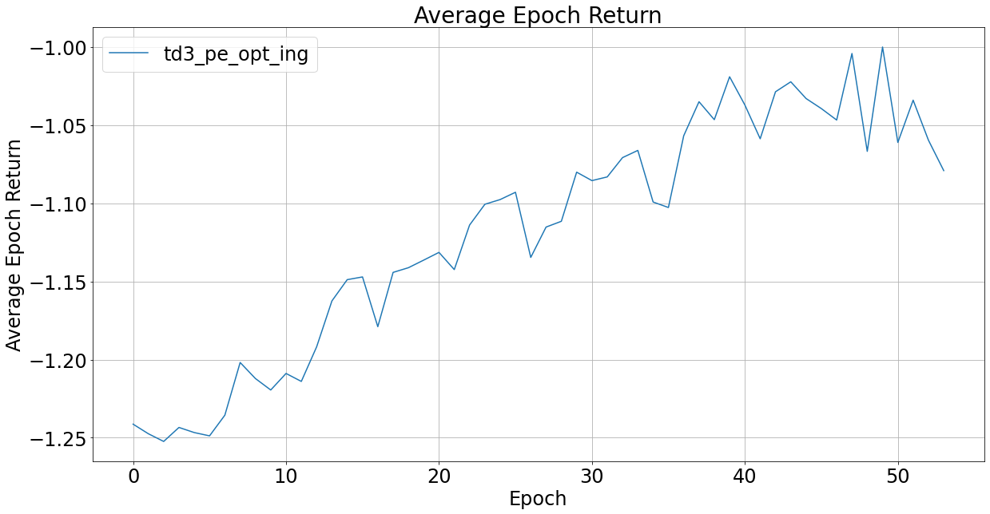
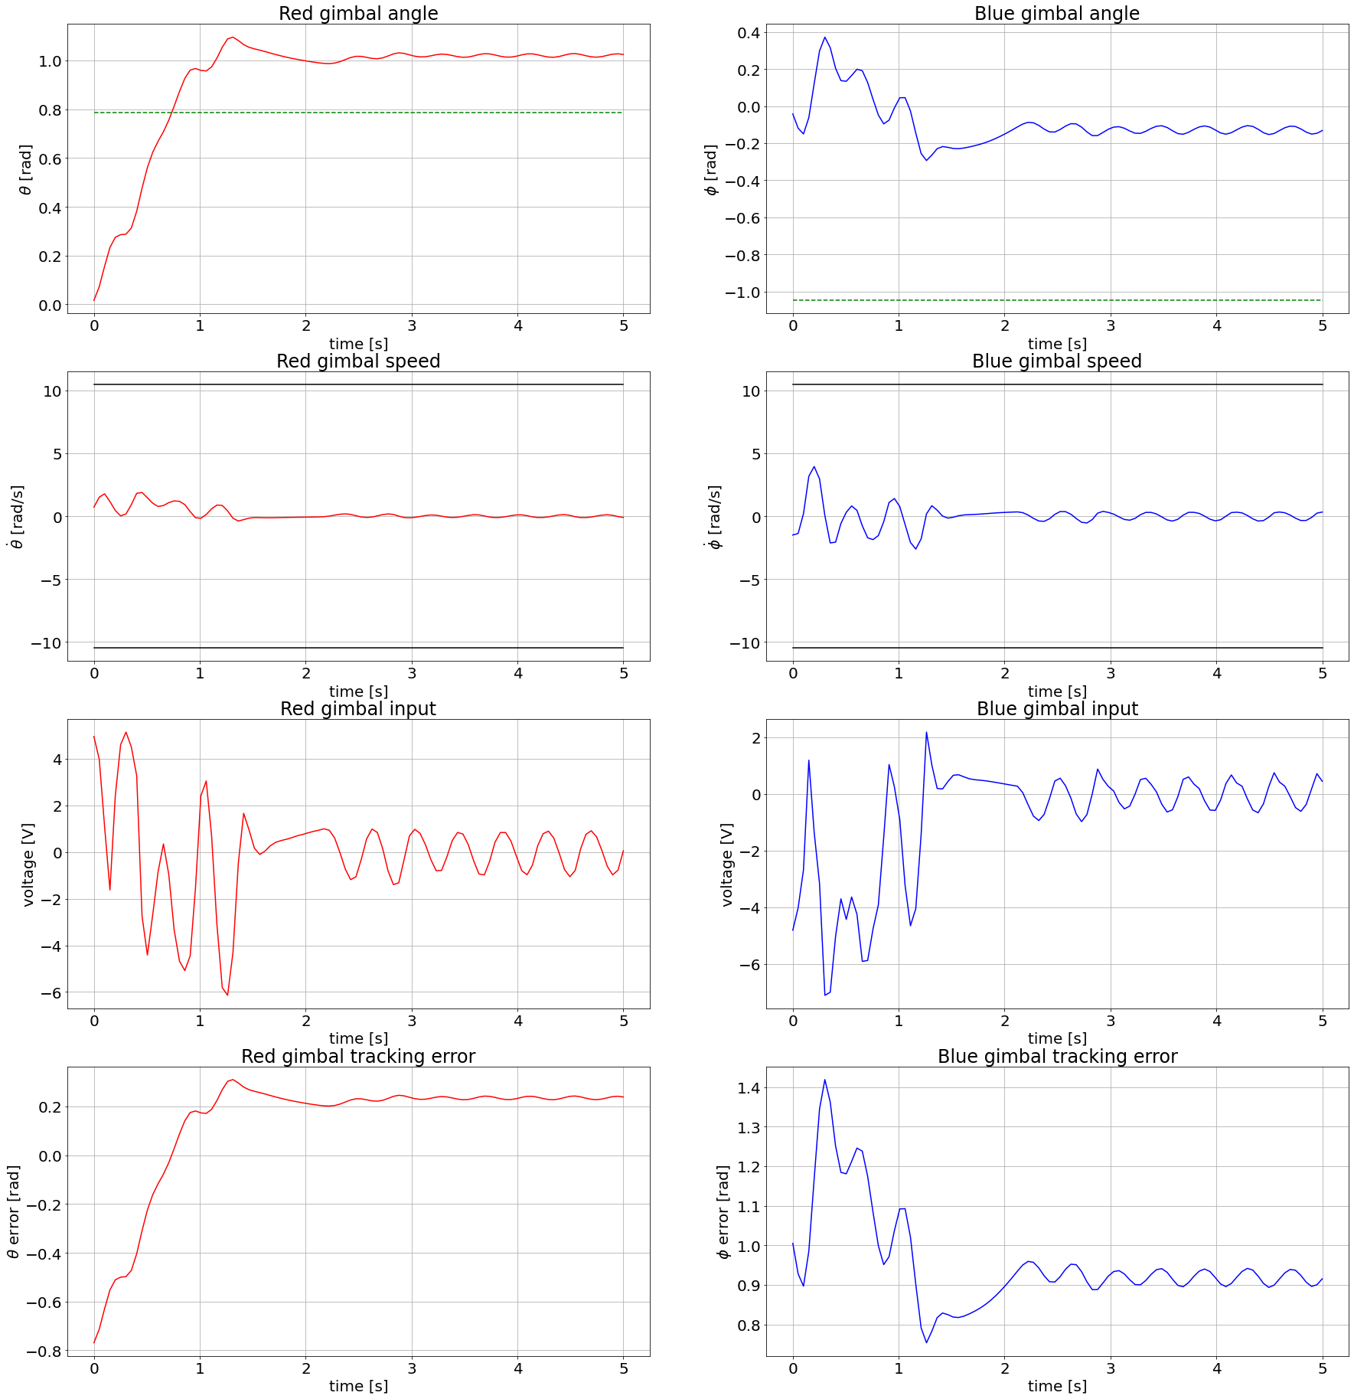
TD3

Slide 11
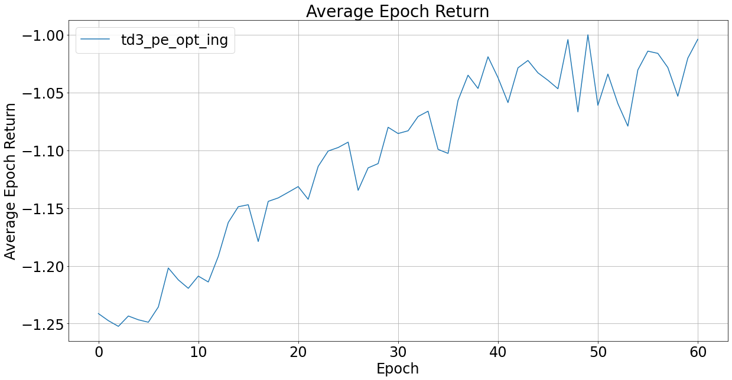
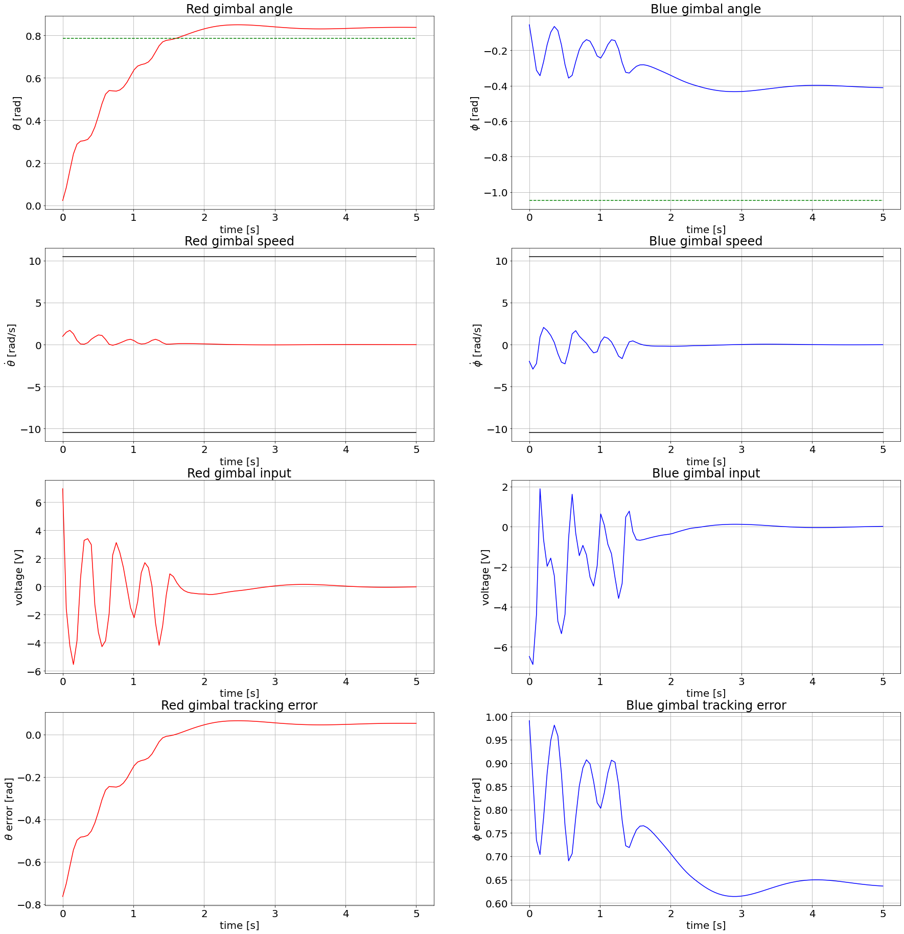
TD3

Slide 12
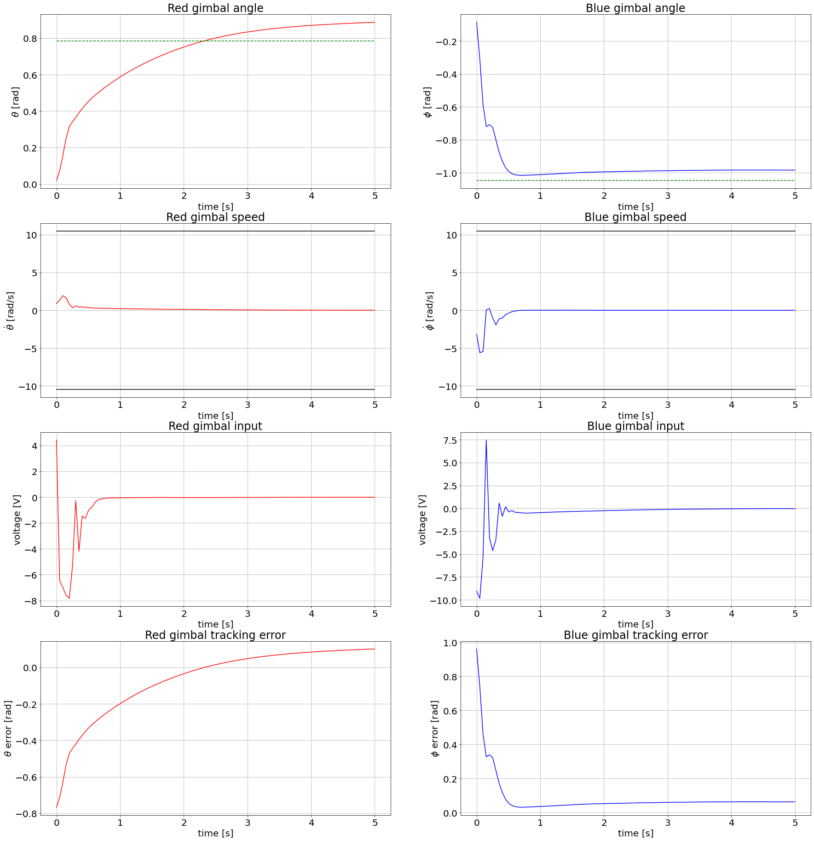
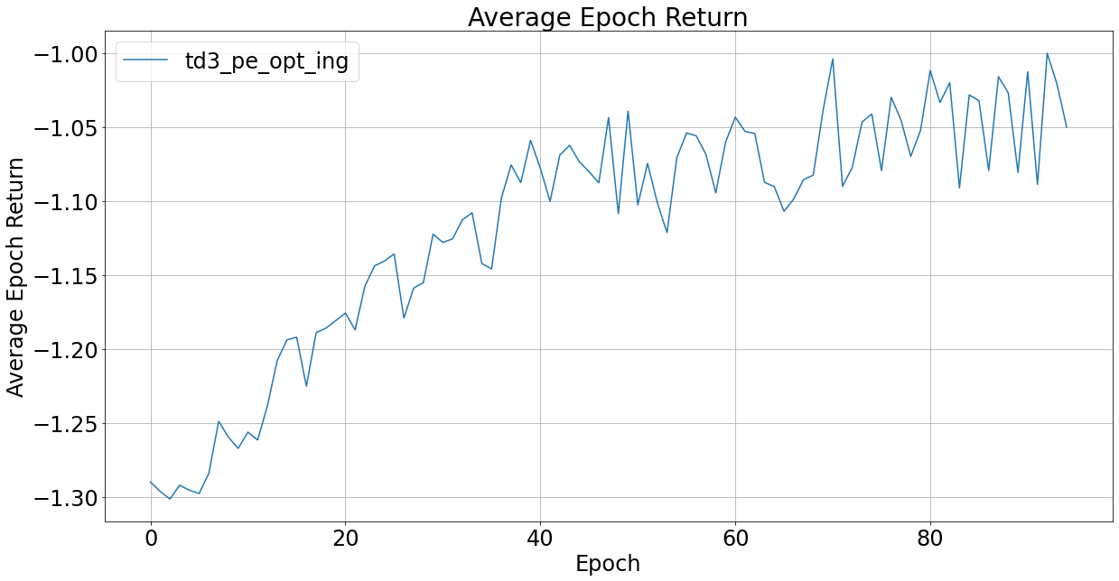
TD3

Slide 13
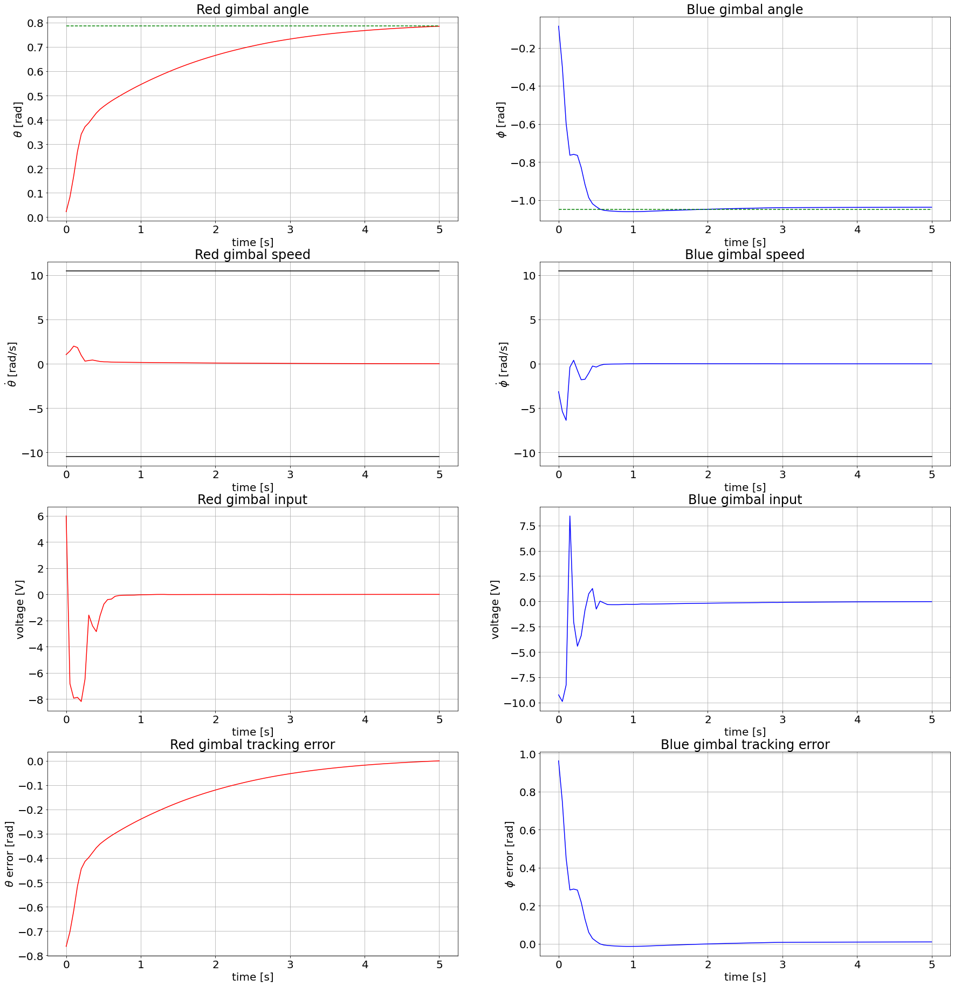
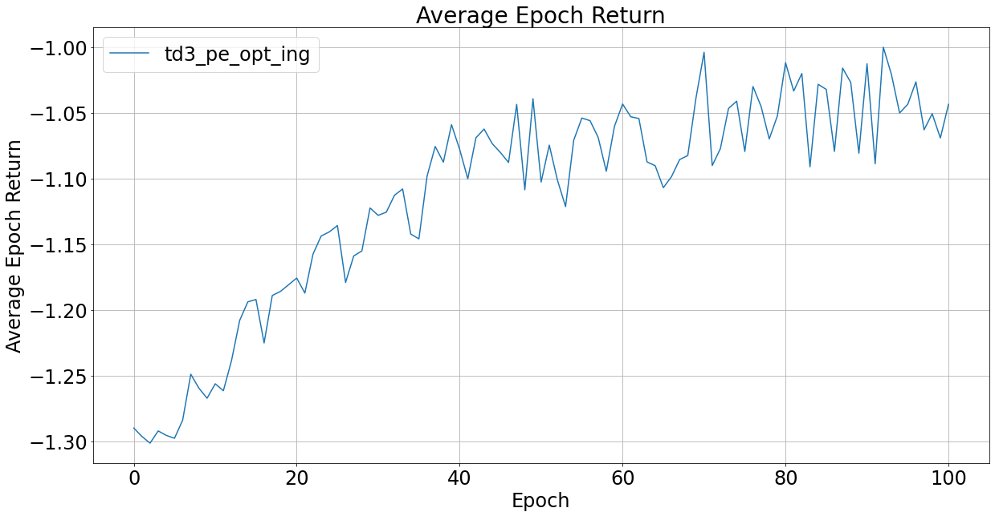
TD3

Slide 14
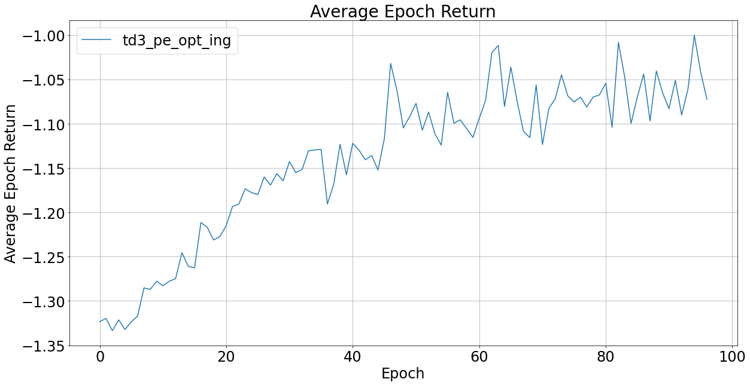
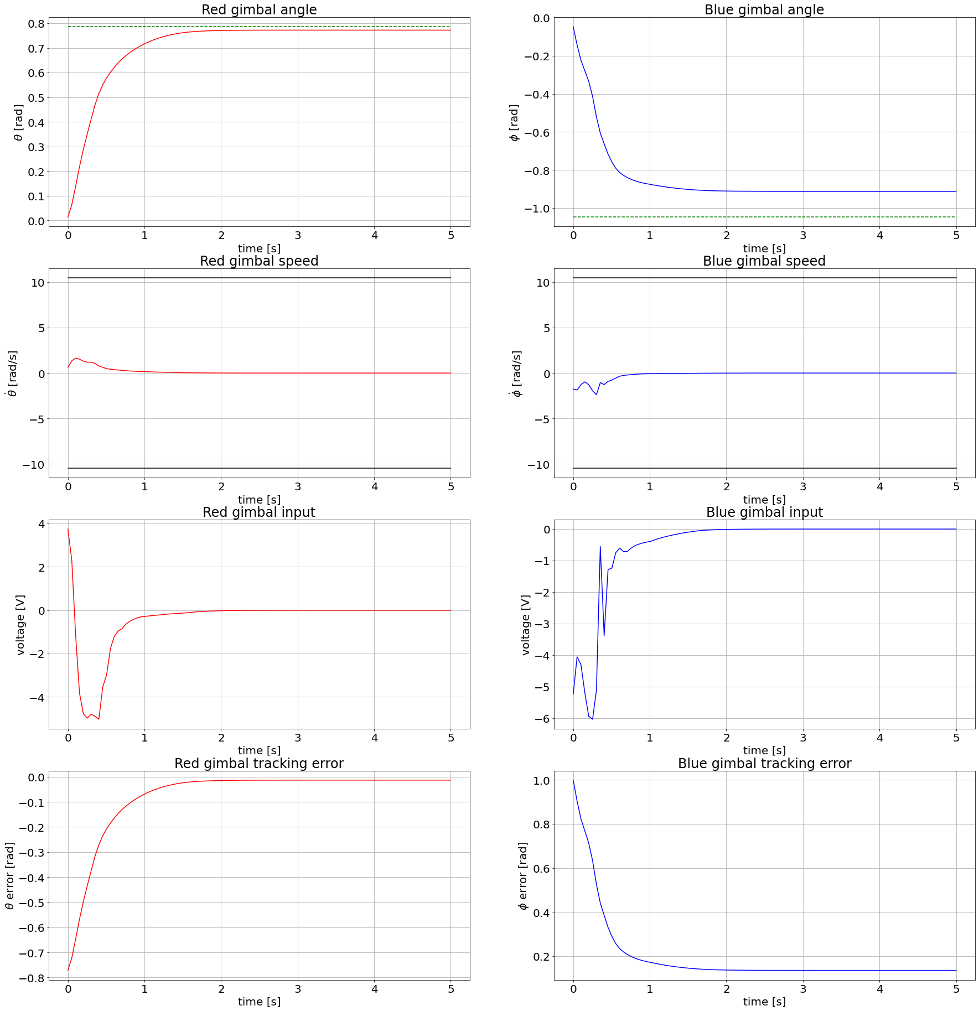
TD3

Slide 15

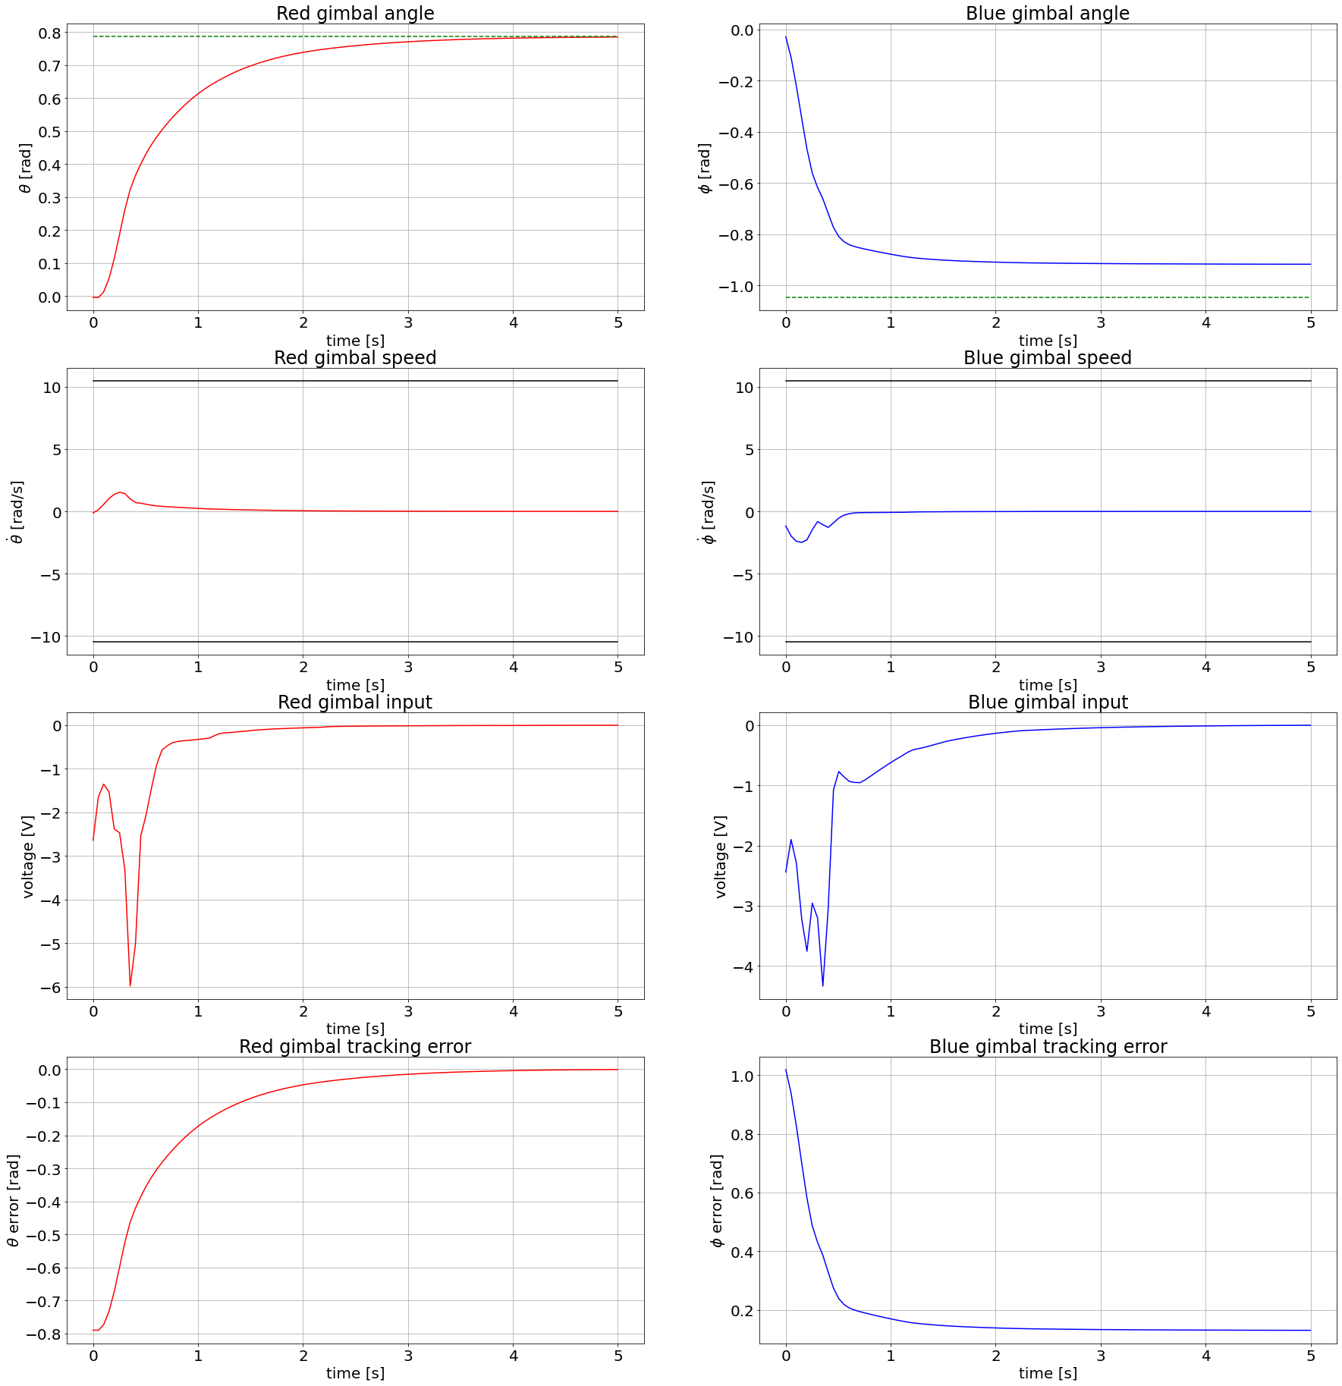
TD3

Slide 16
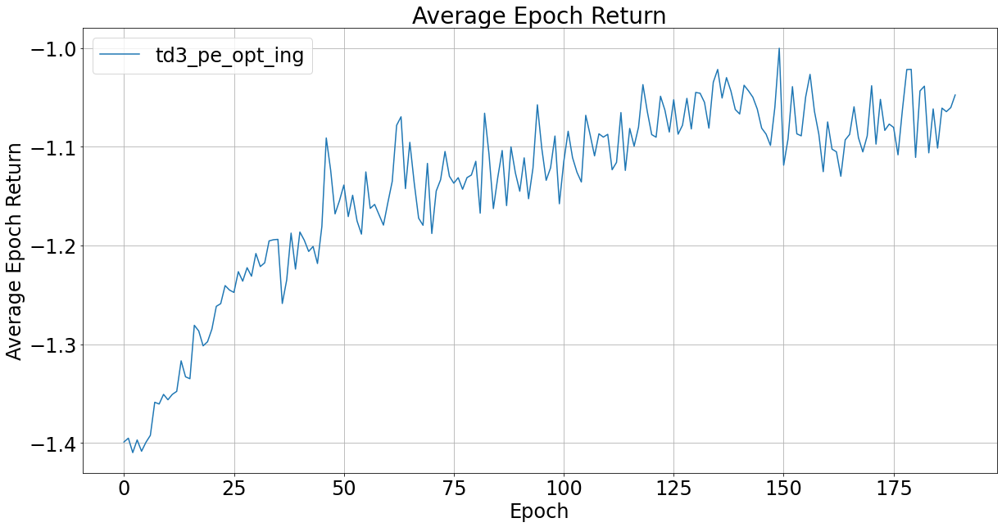
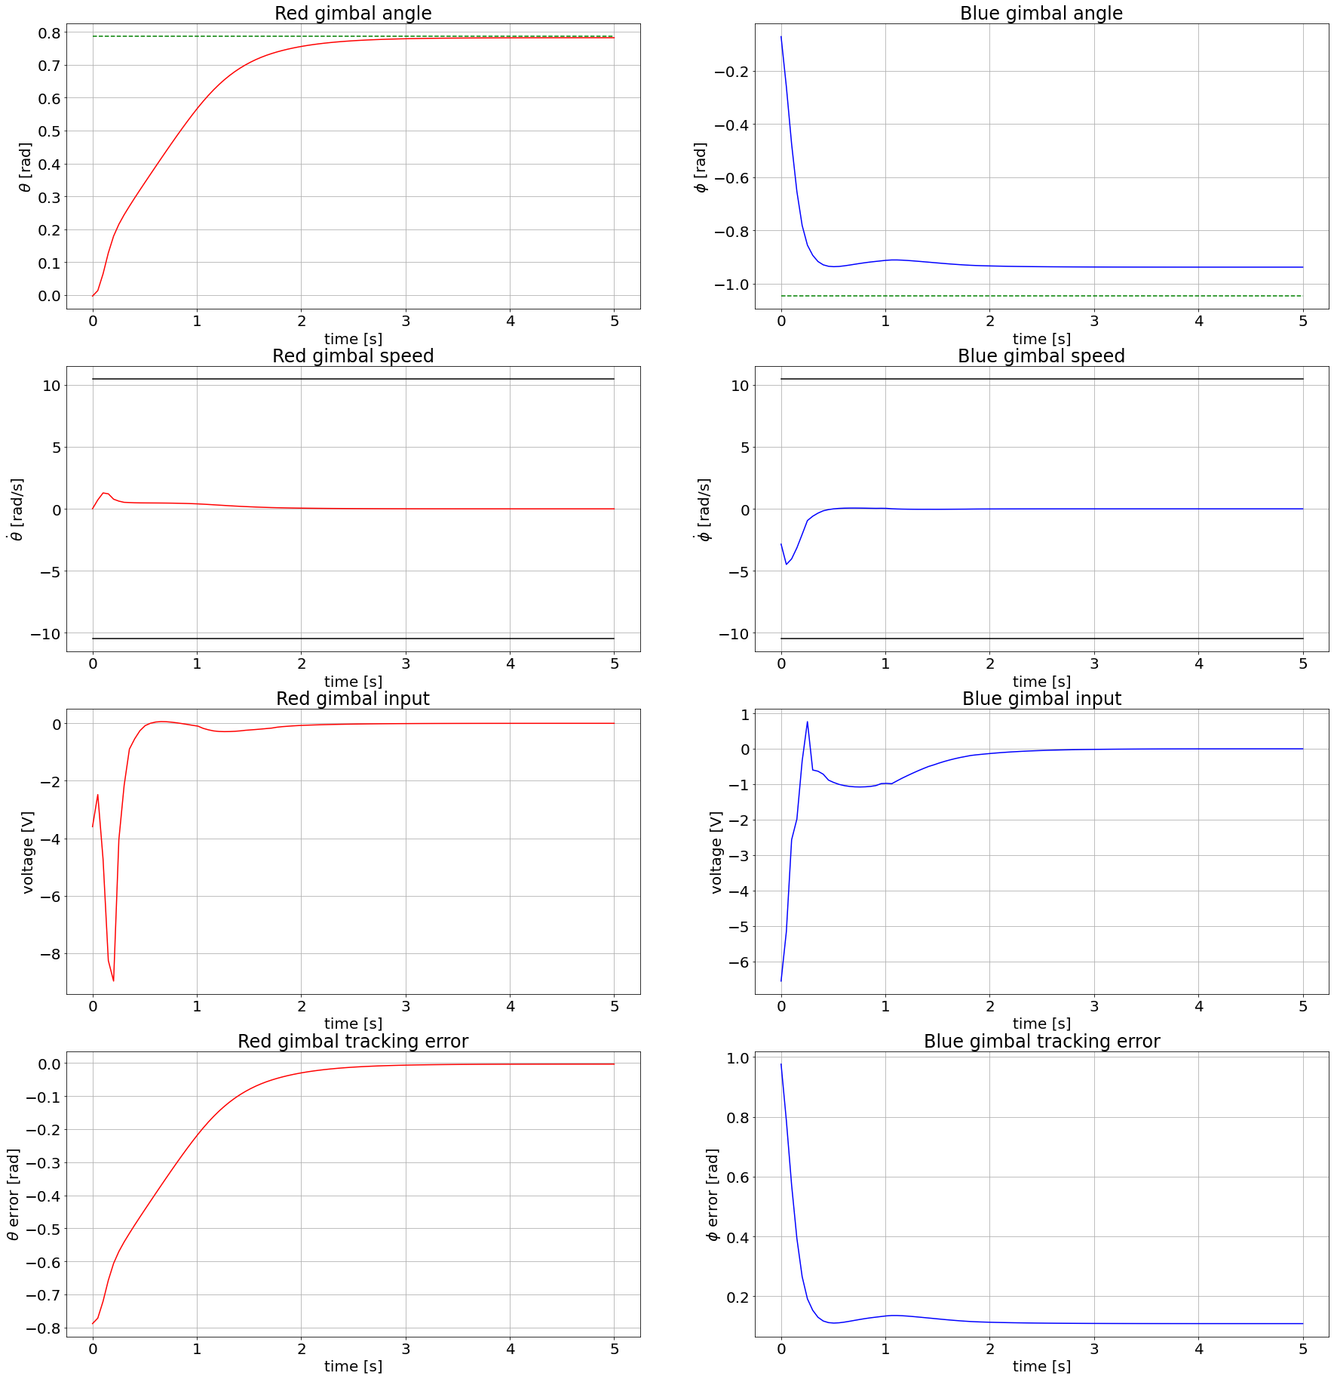
TD3

Slide 17

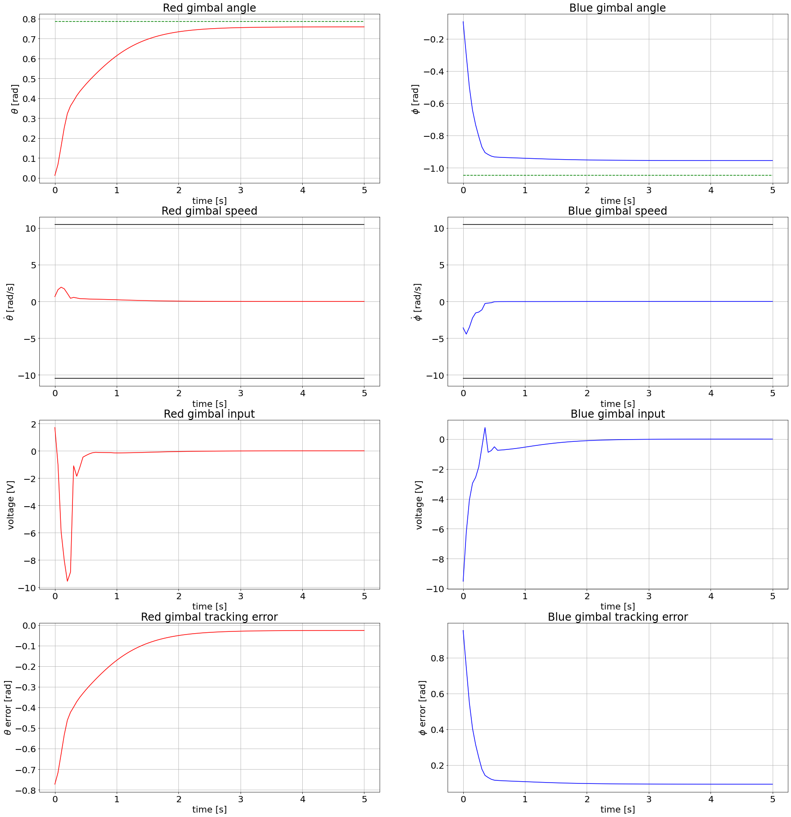
TD3

Slide 18
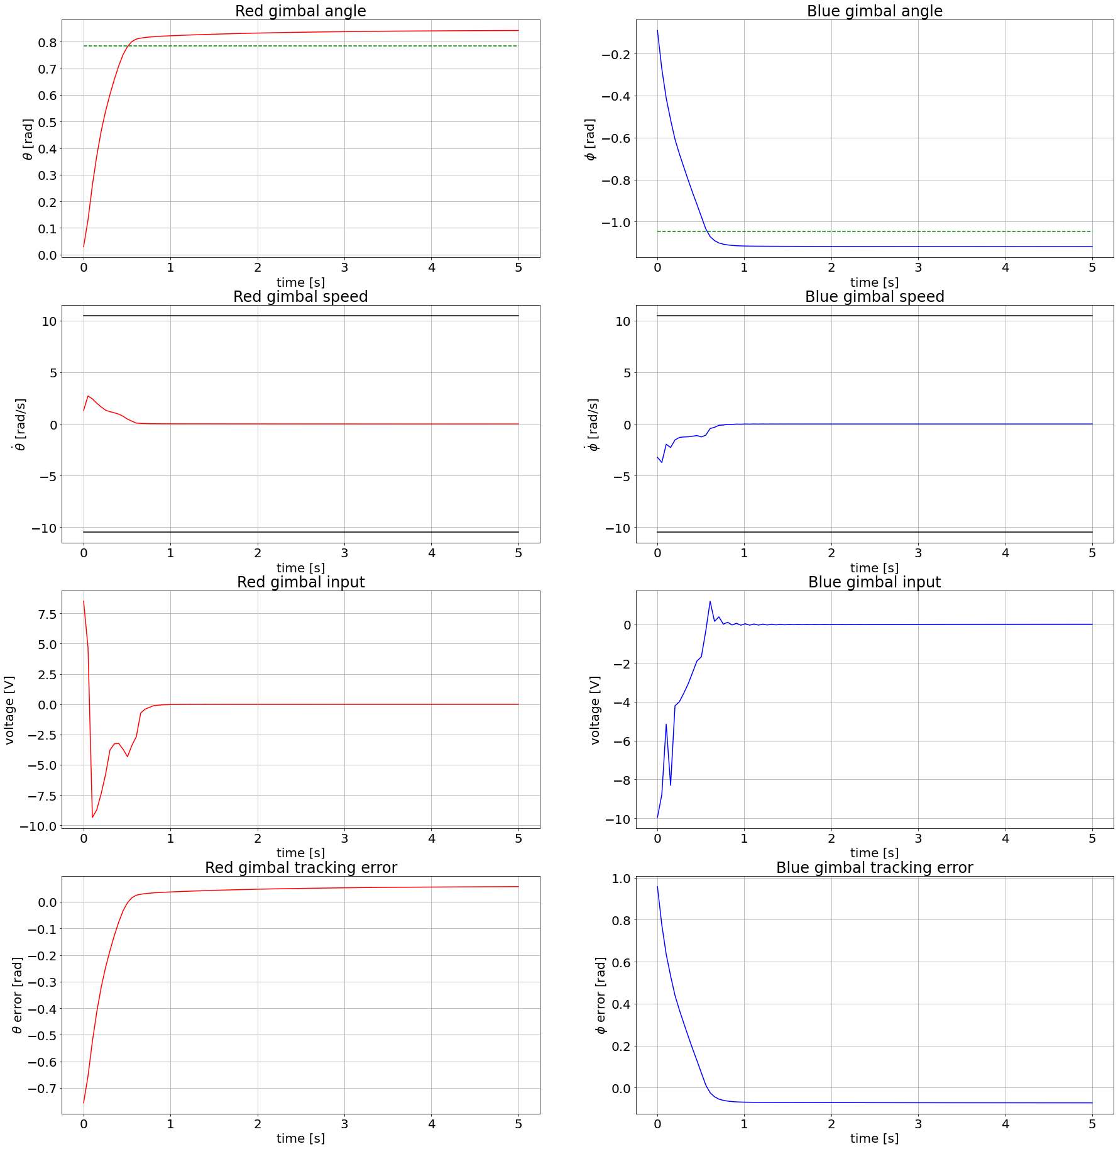
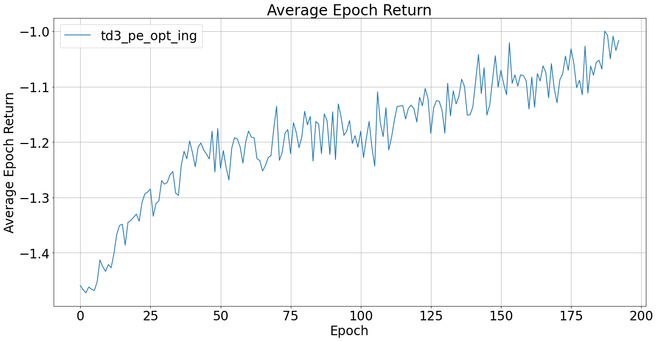
TD3

Slide 19
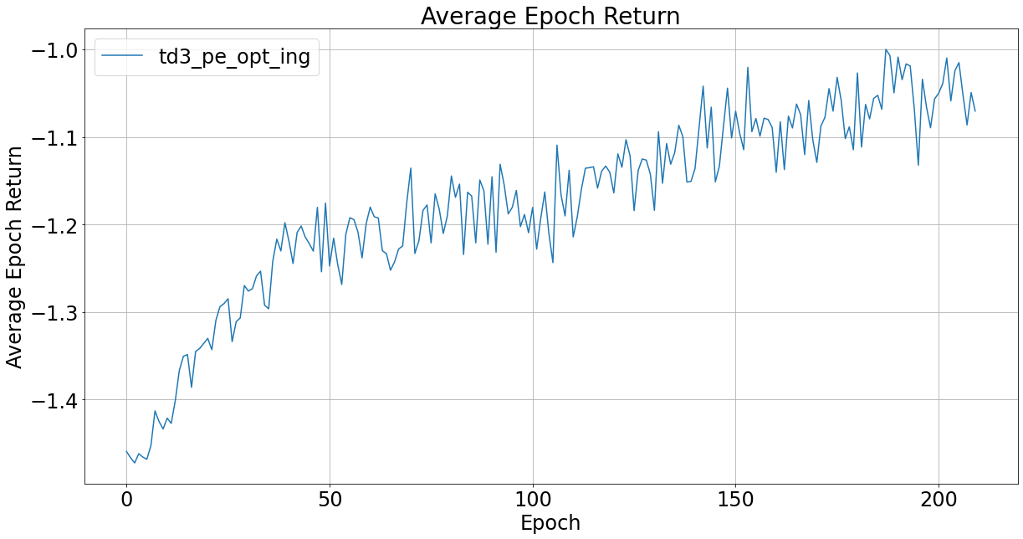
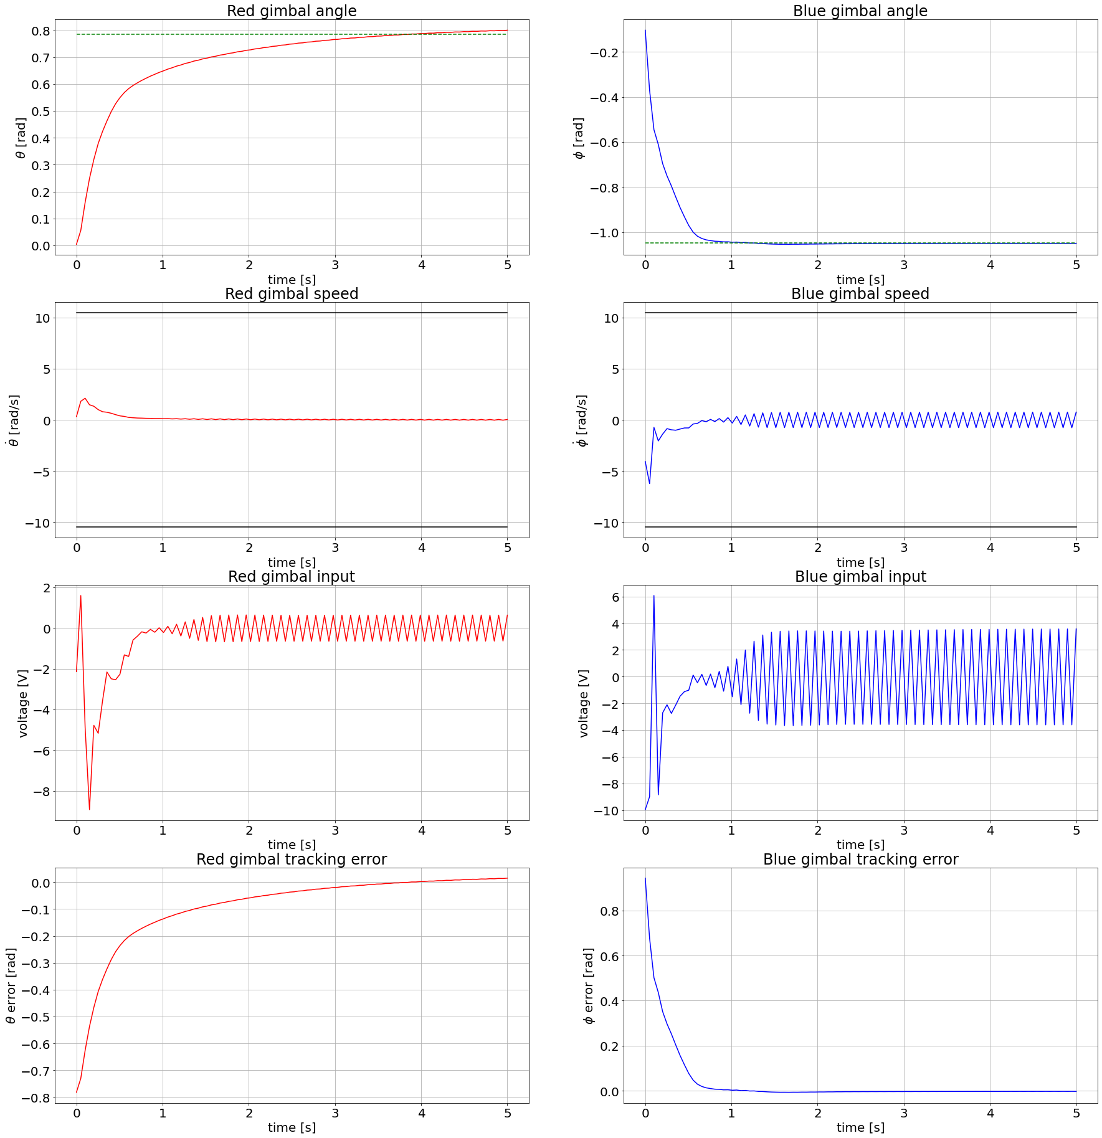
TD3

Slide 20
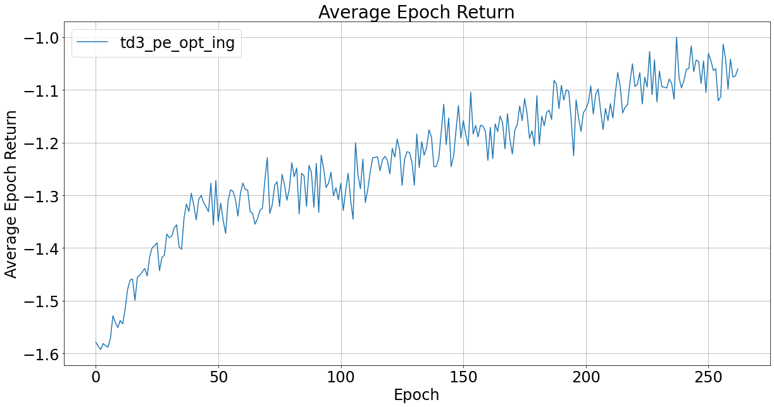
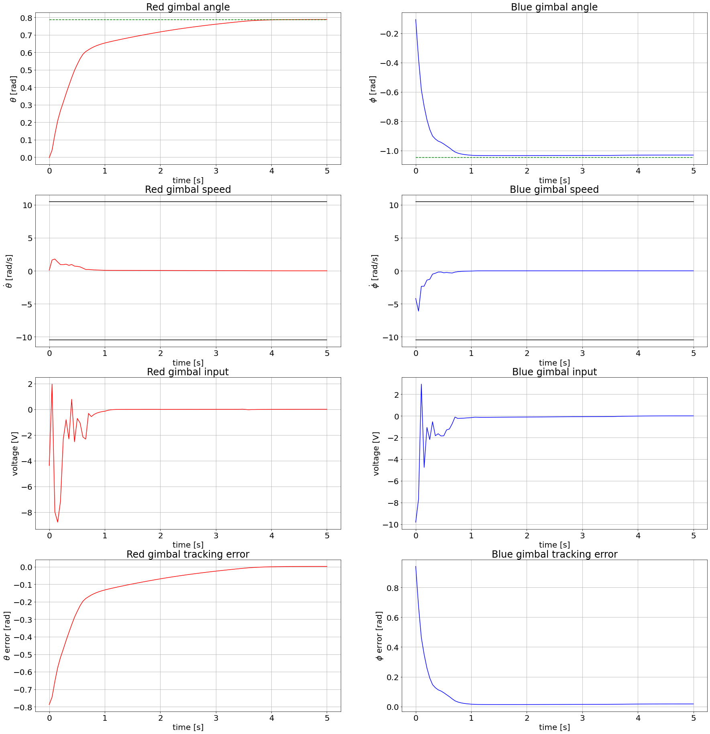
TD3

Slide 21

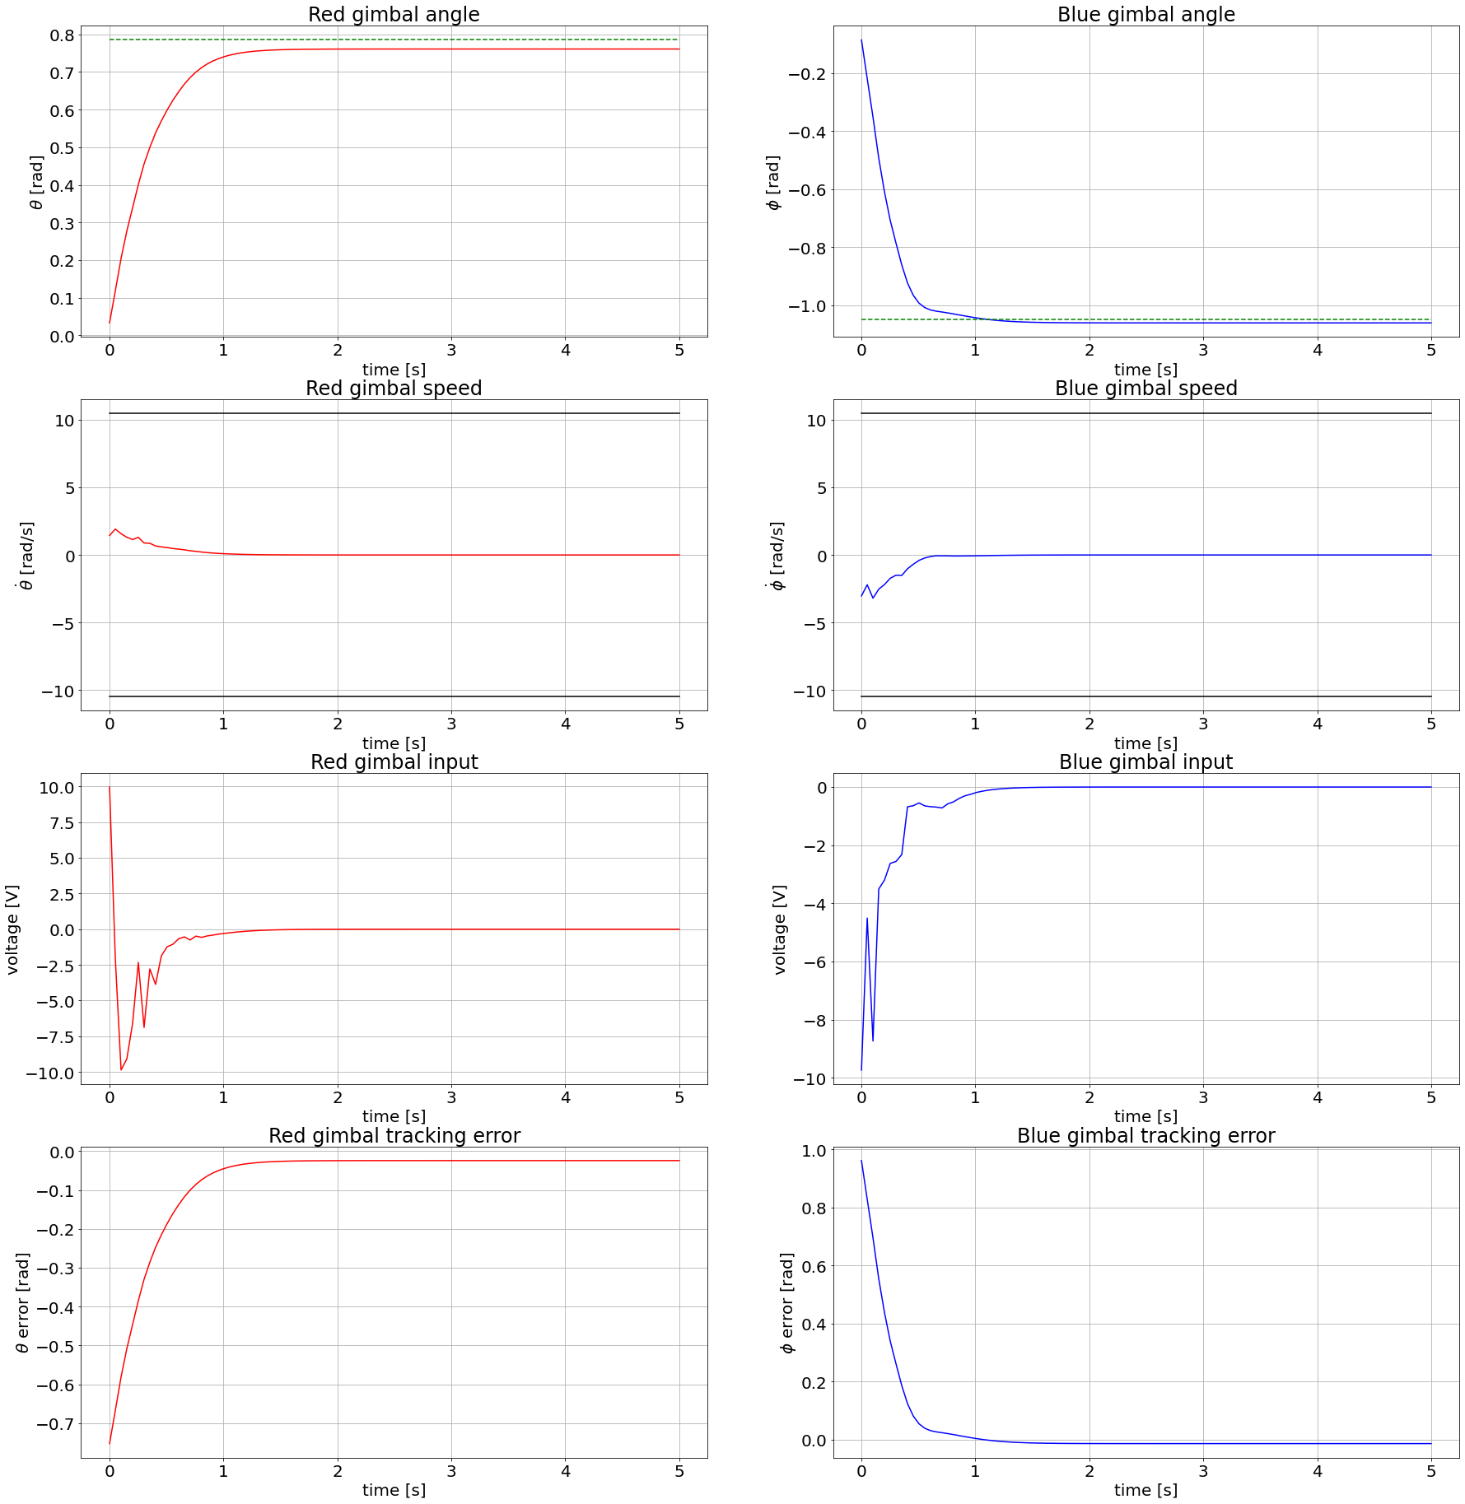
TD3

Slide 22
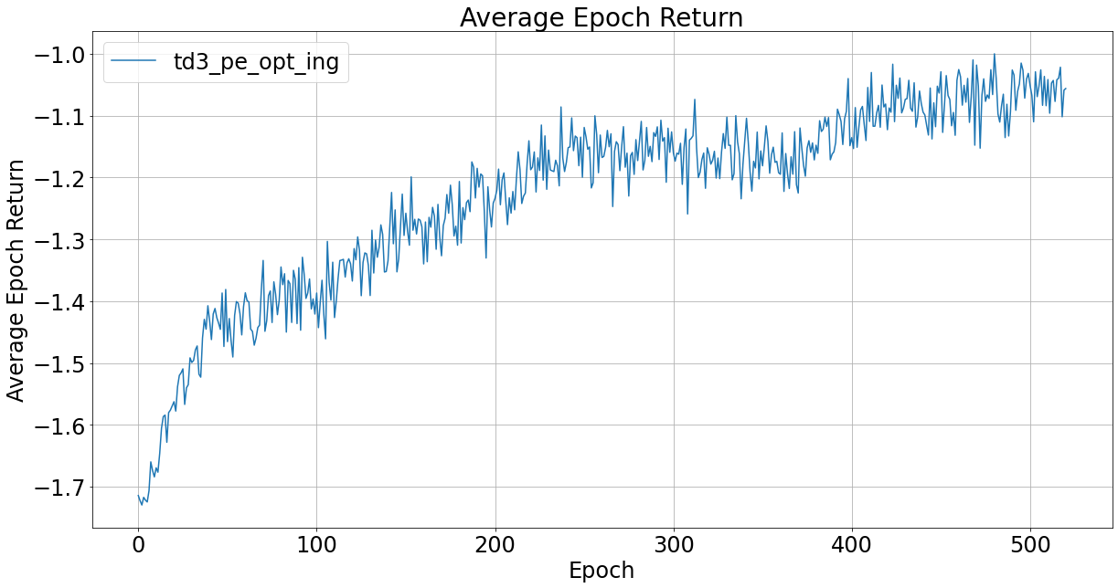
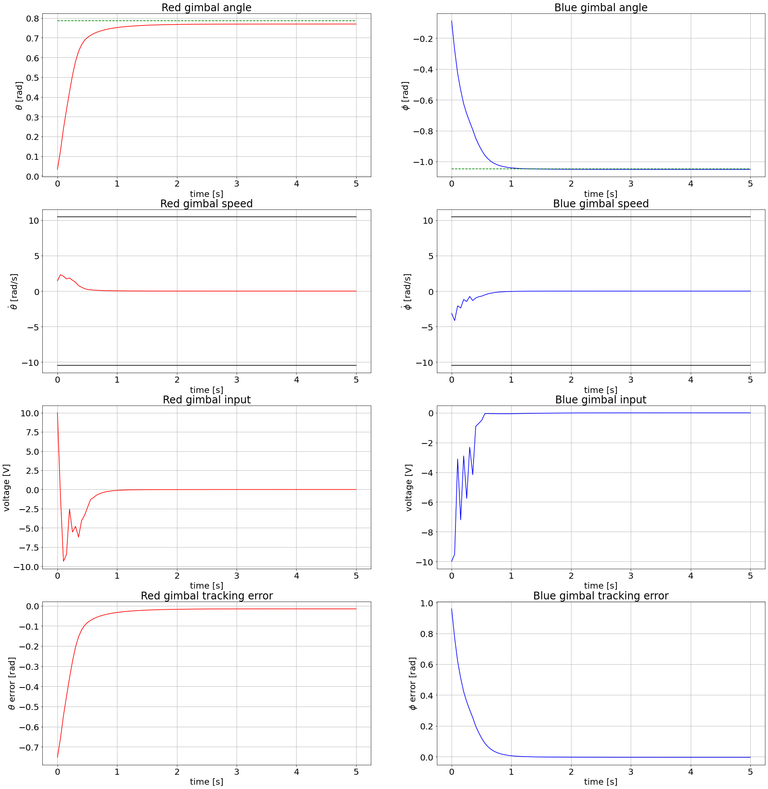
TD3

Slide 23
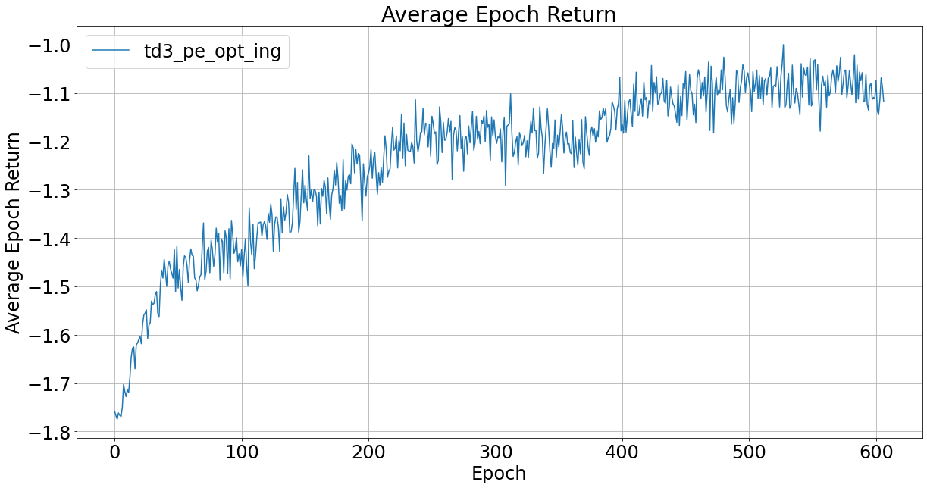

TD3

Slide 24
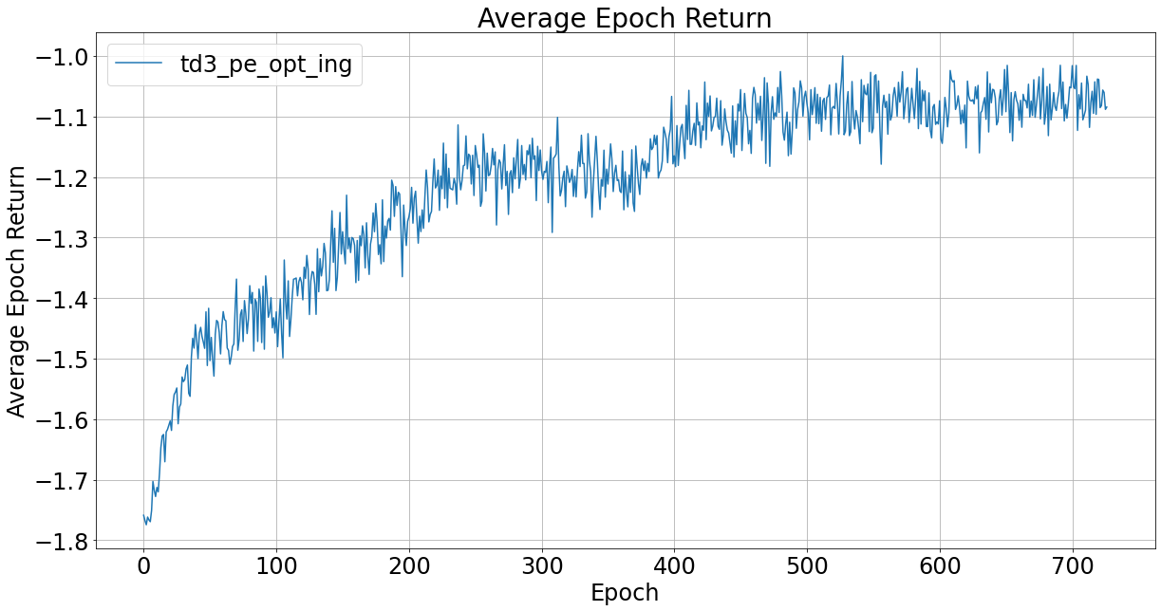
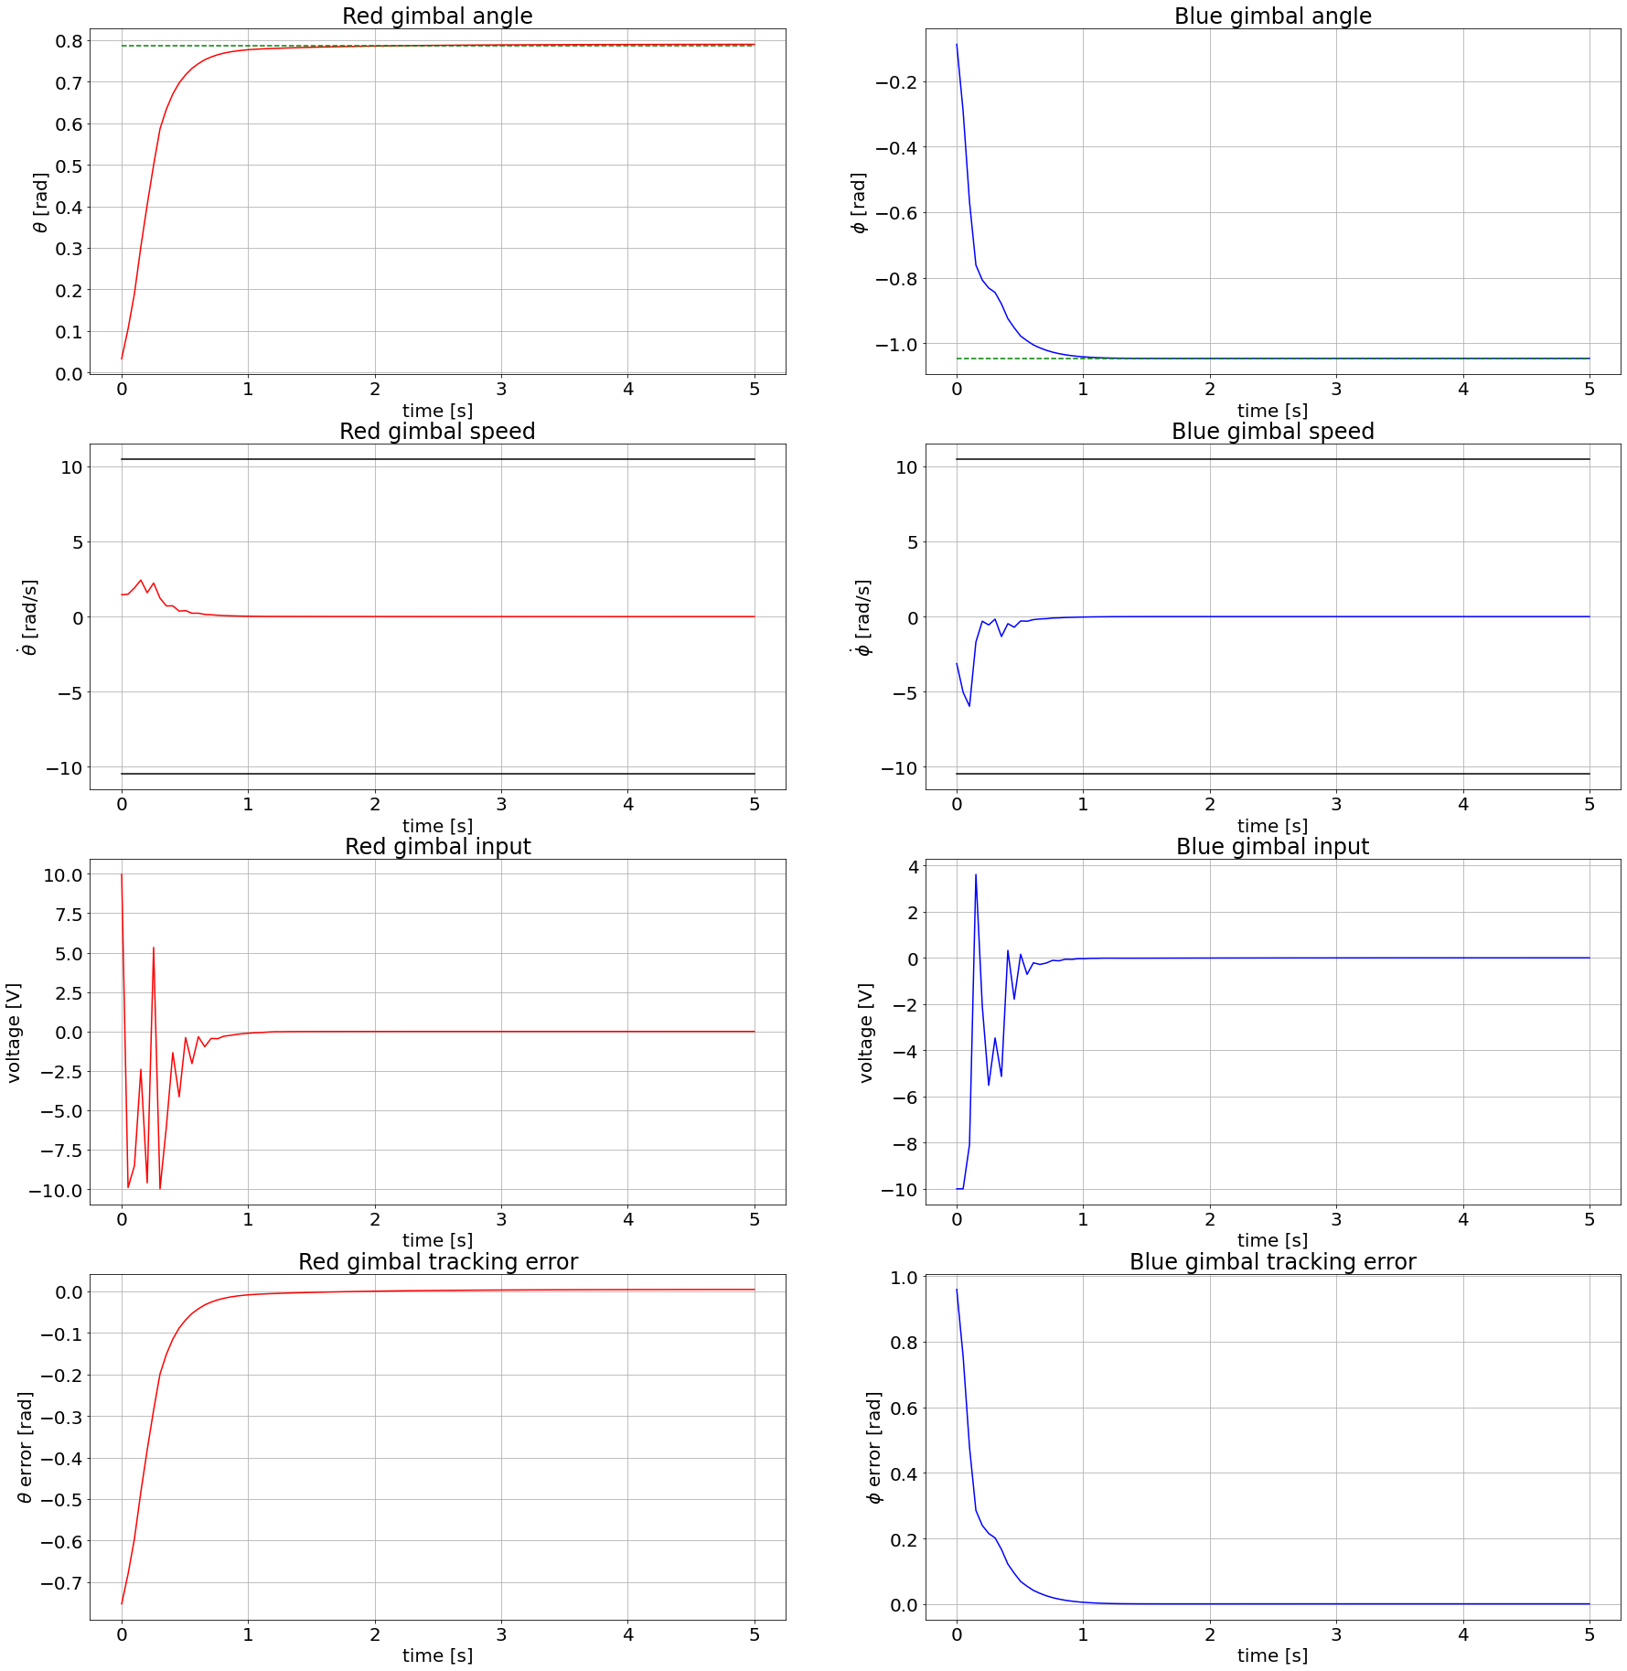
TD3

Slide 25
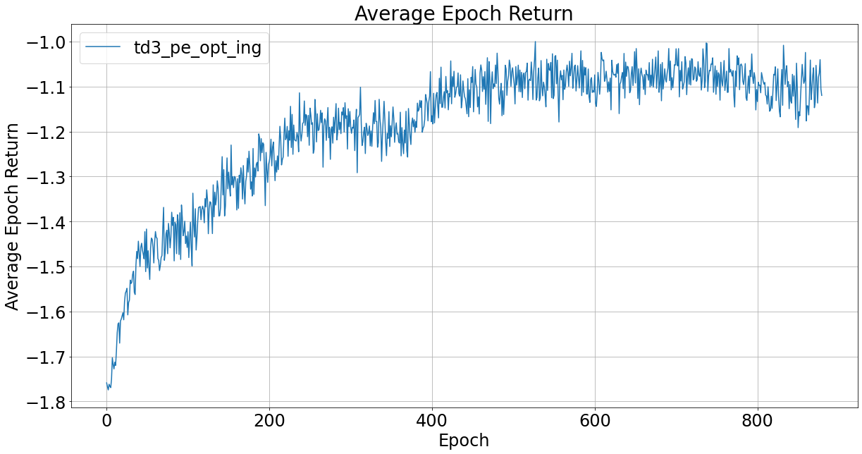
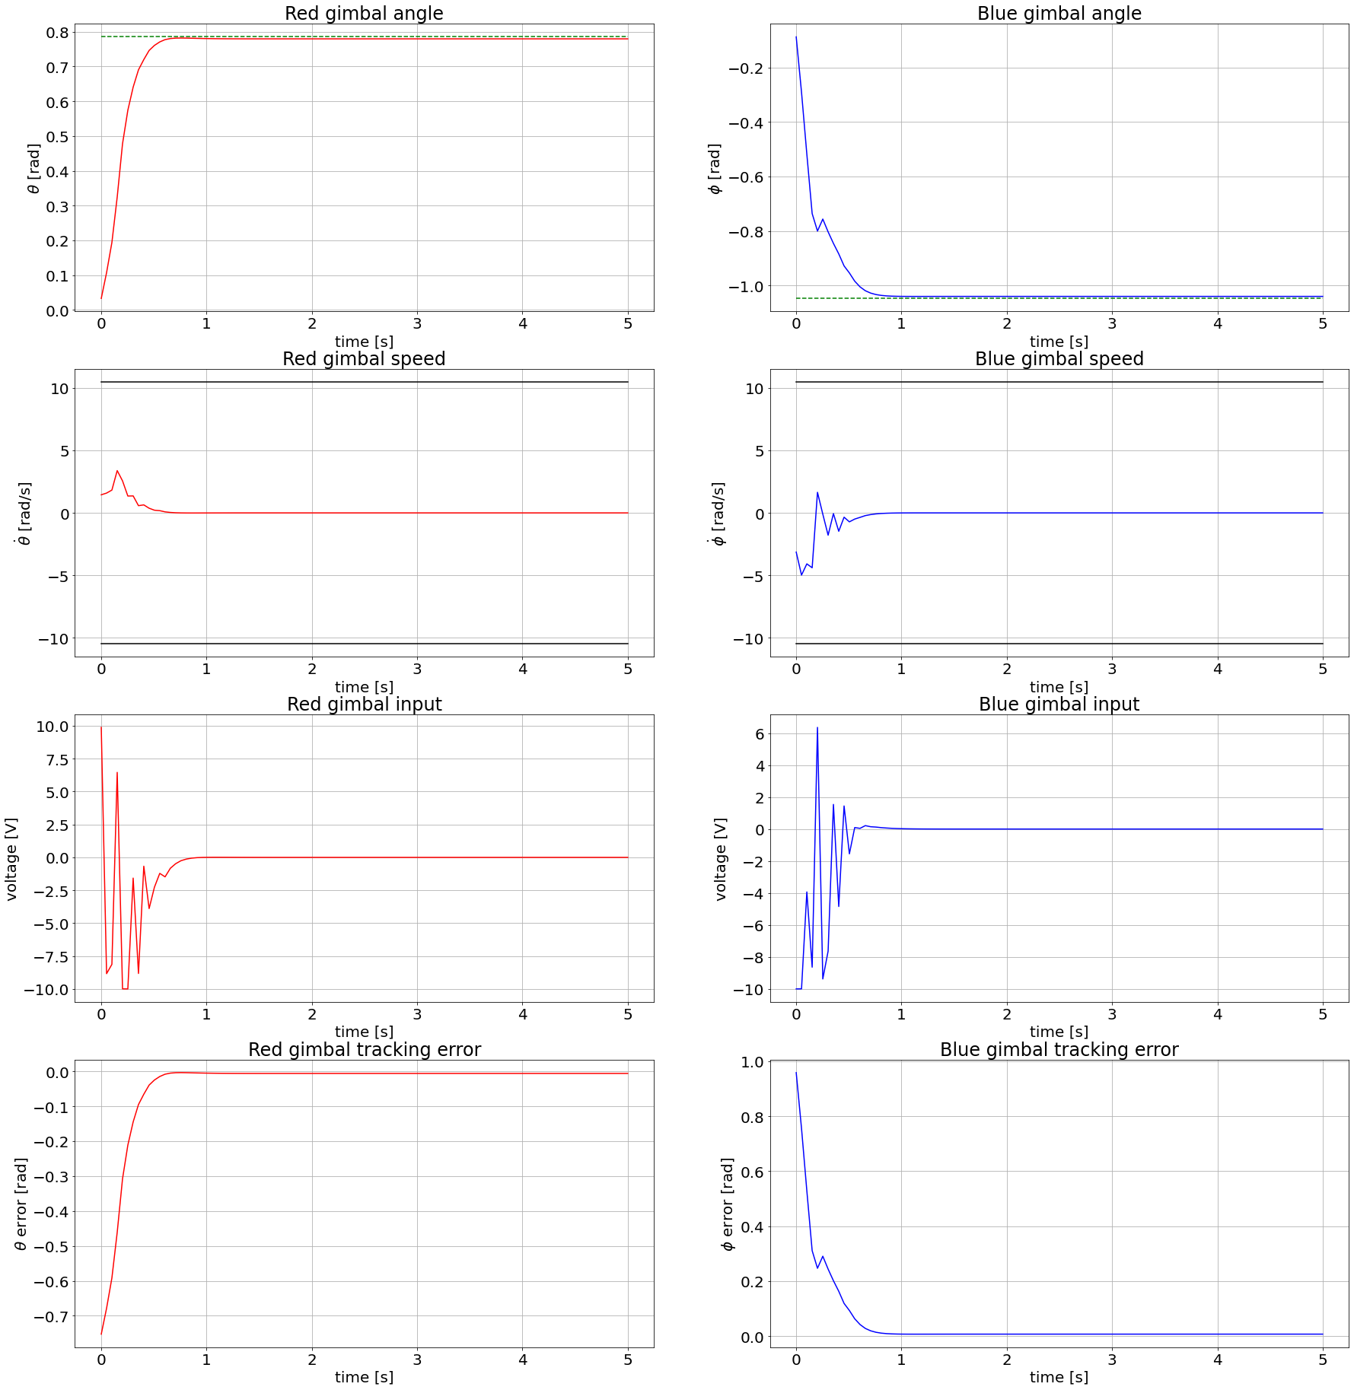
TD3

Slide 26
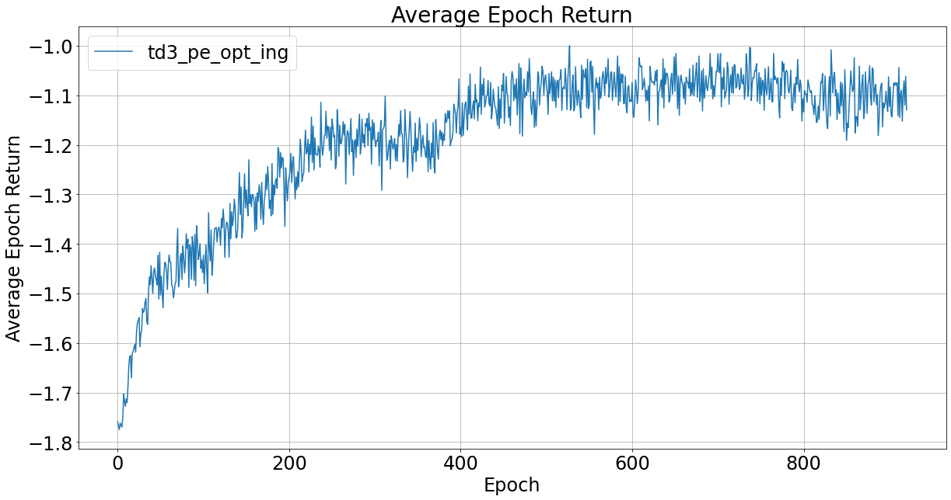

TD3

Slide 27
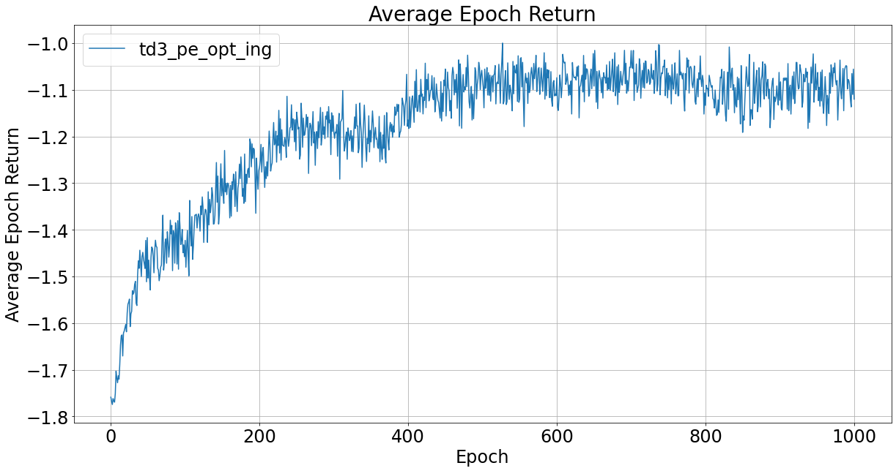
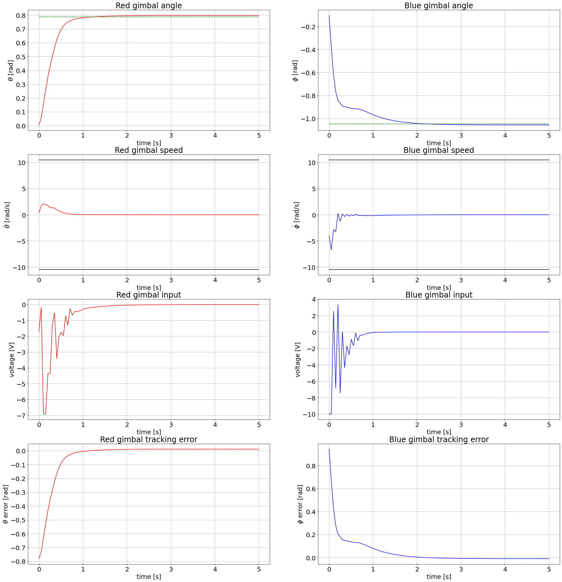
TD3

Slide 28
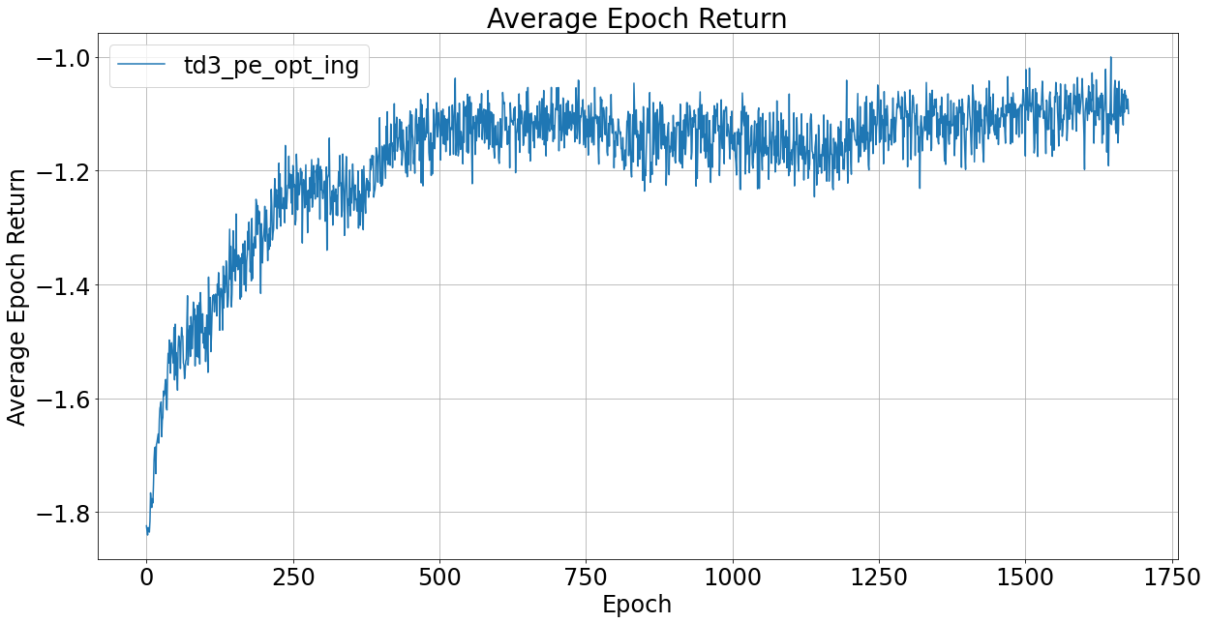
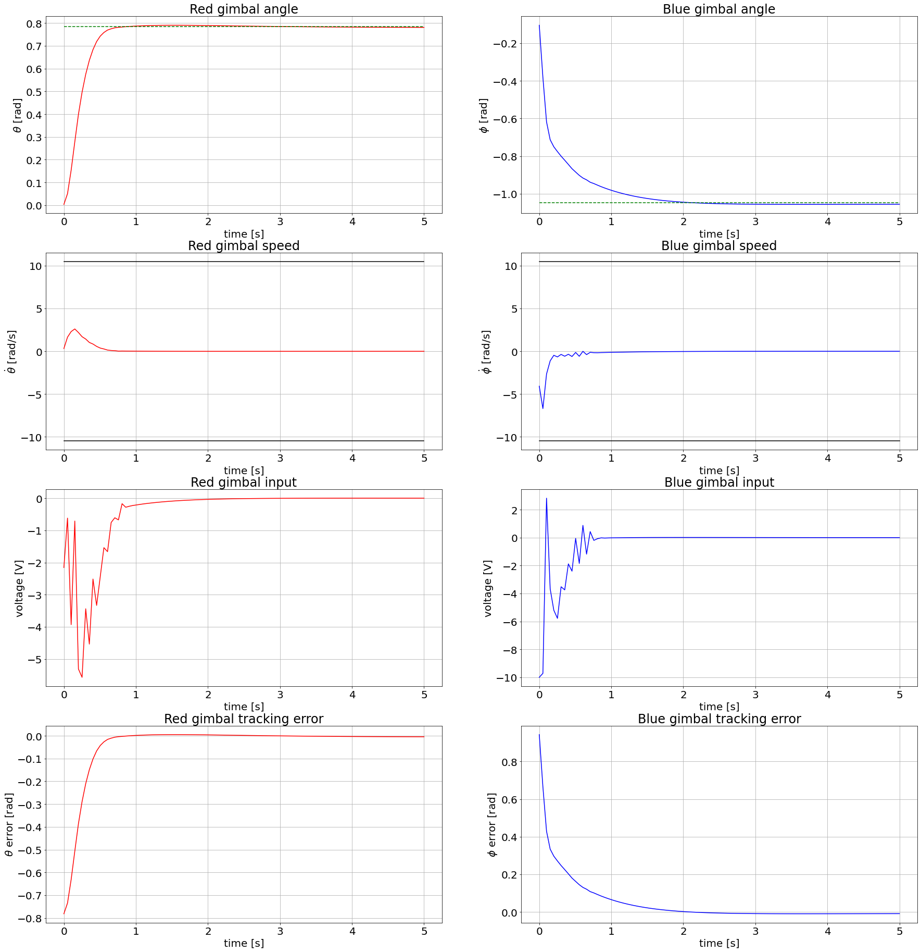
TD3

Slide 29
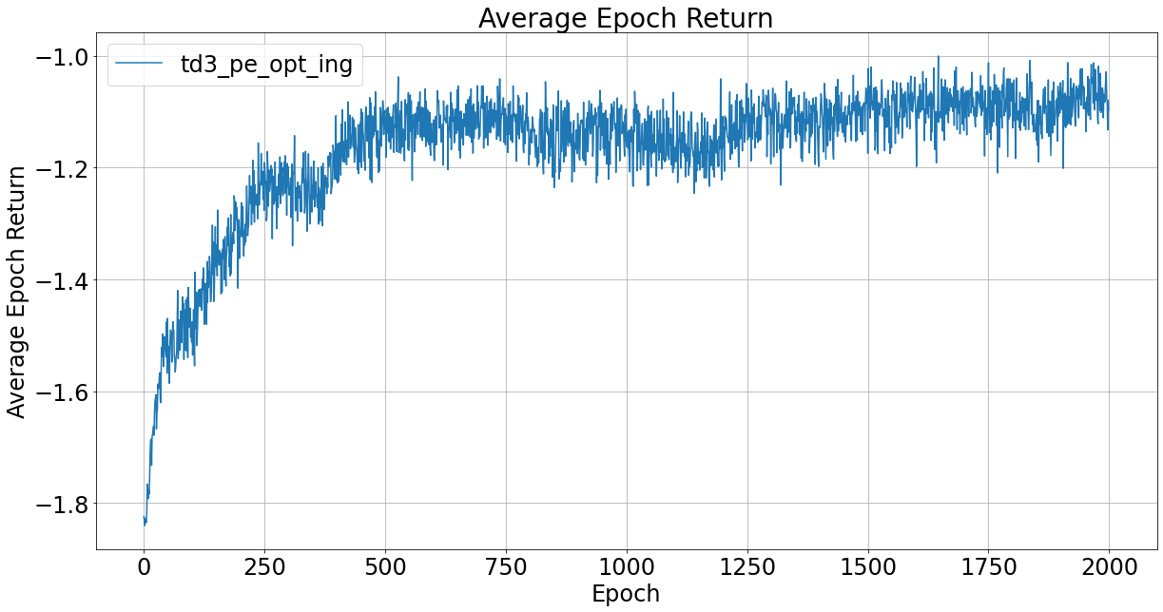
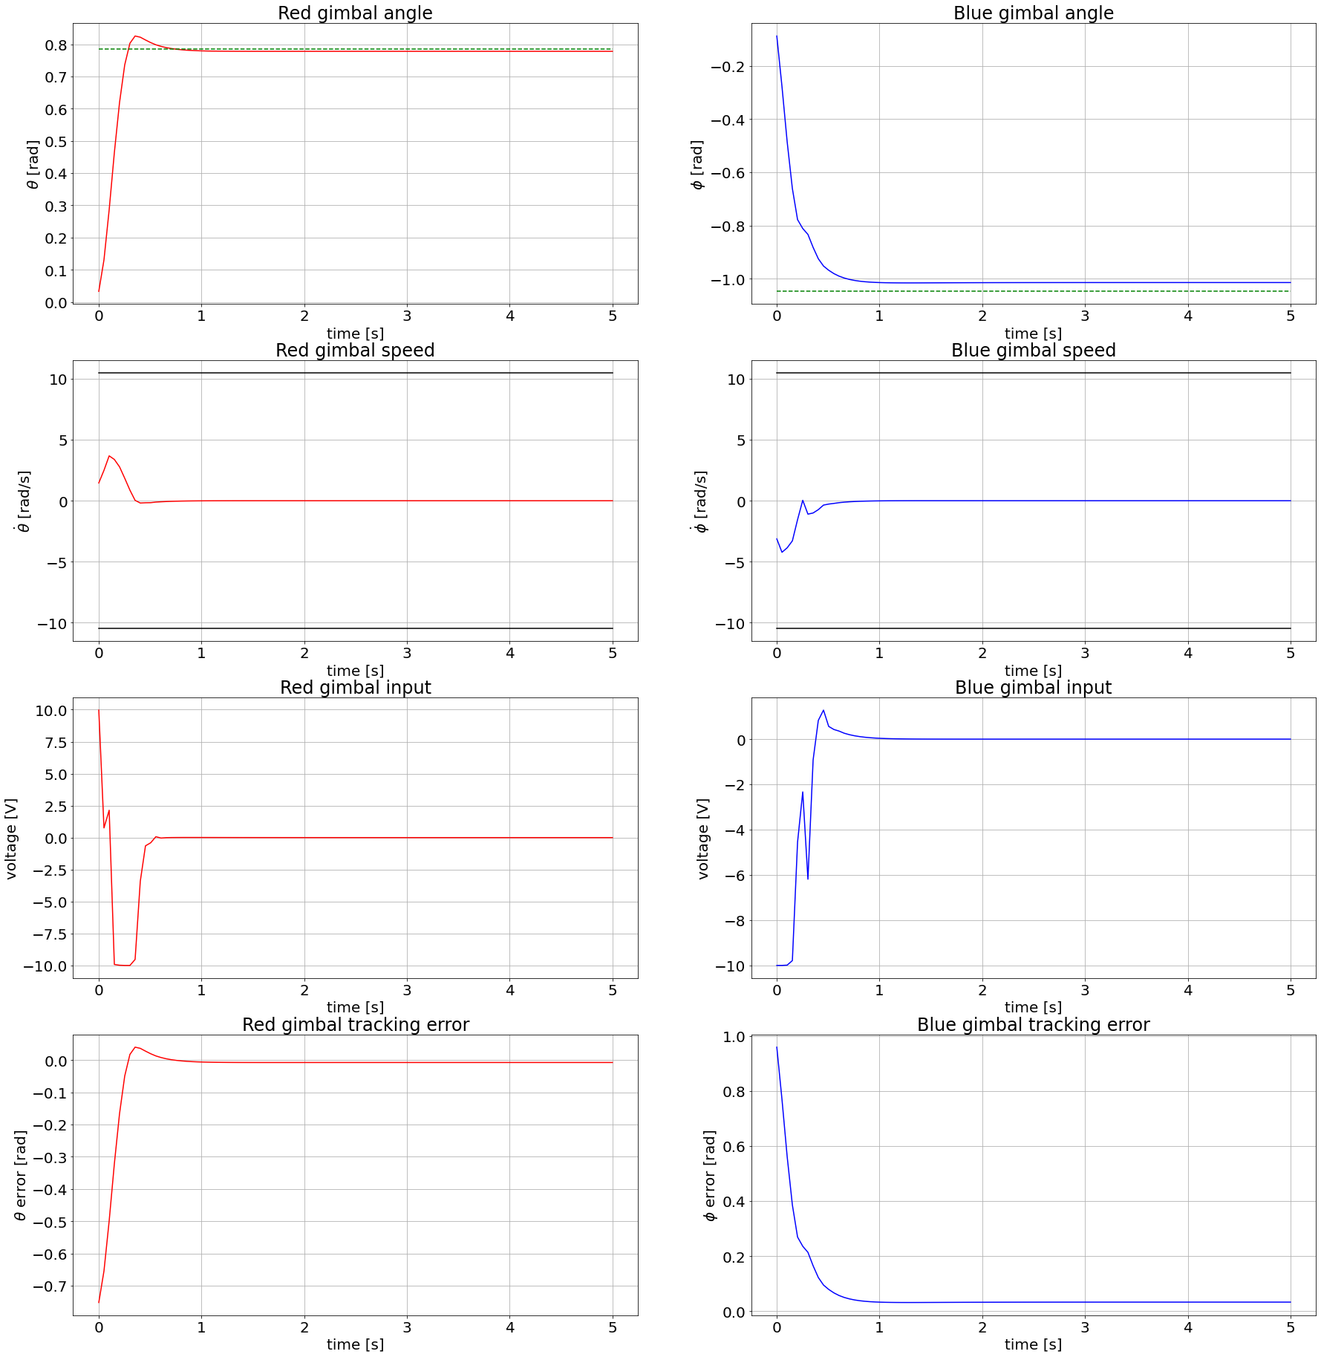
TD3

Slide 33
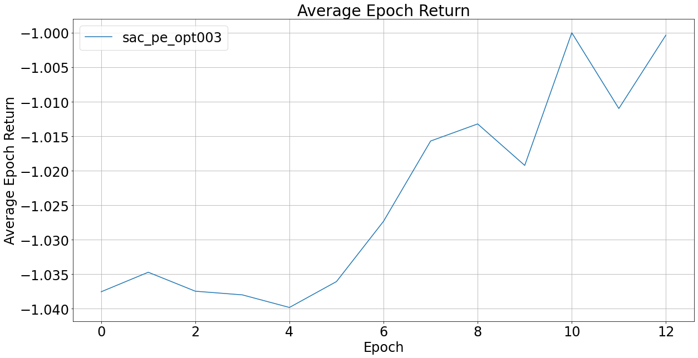
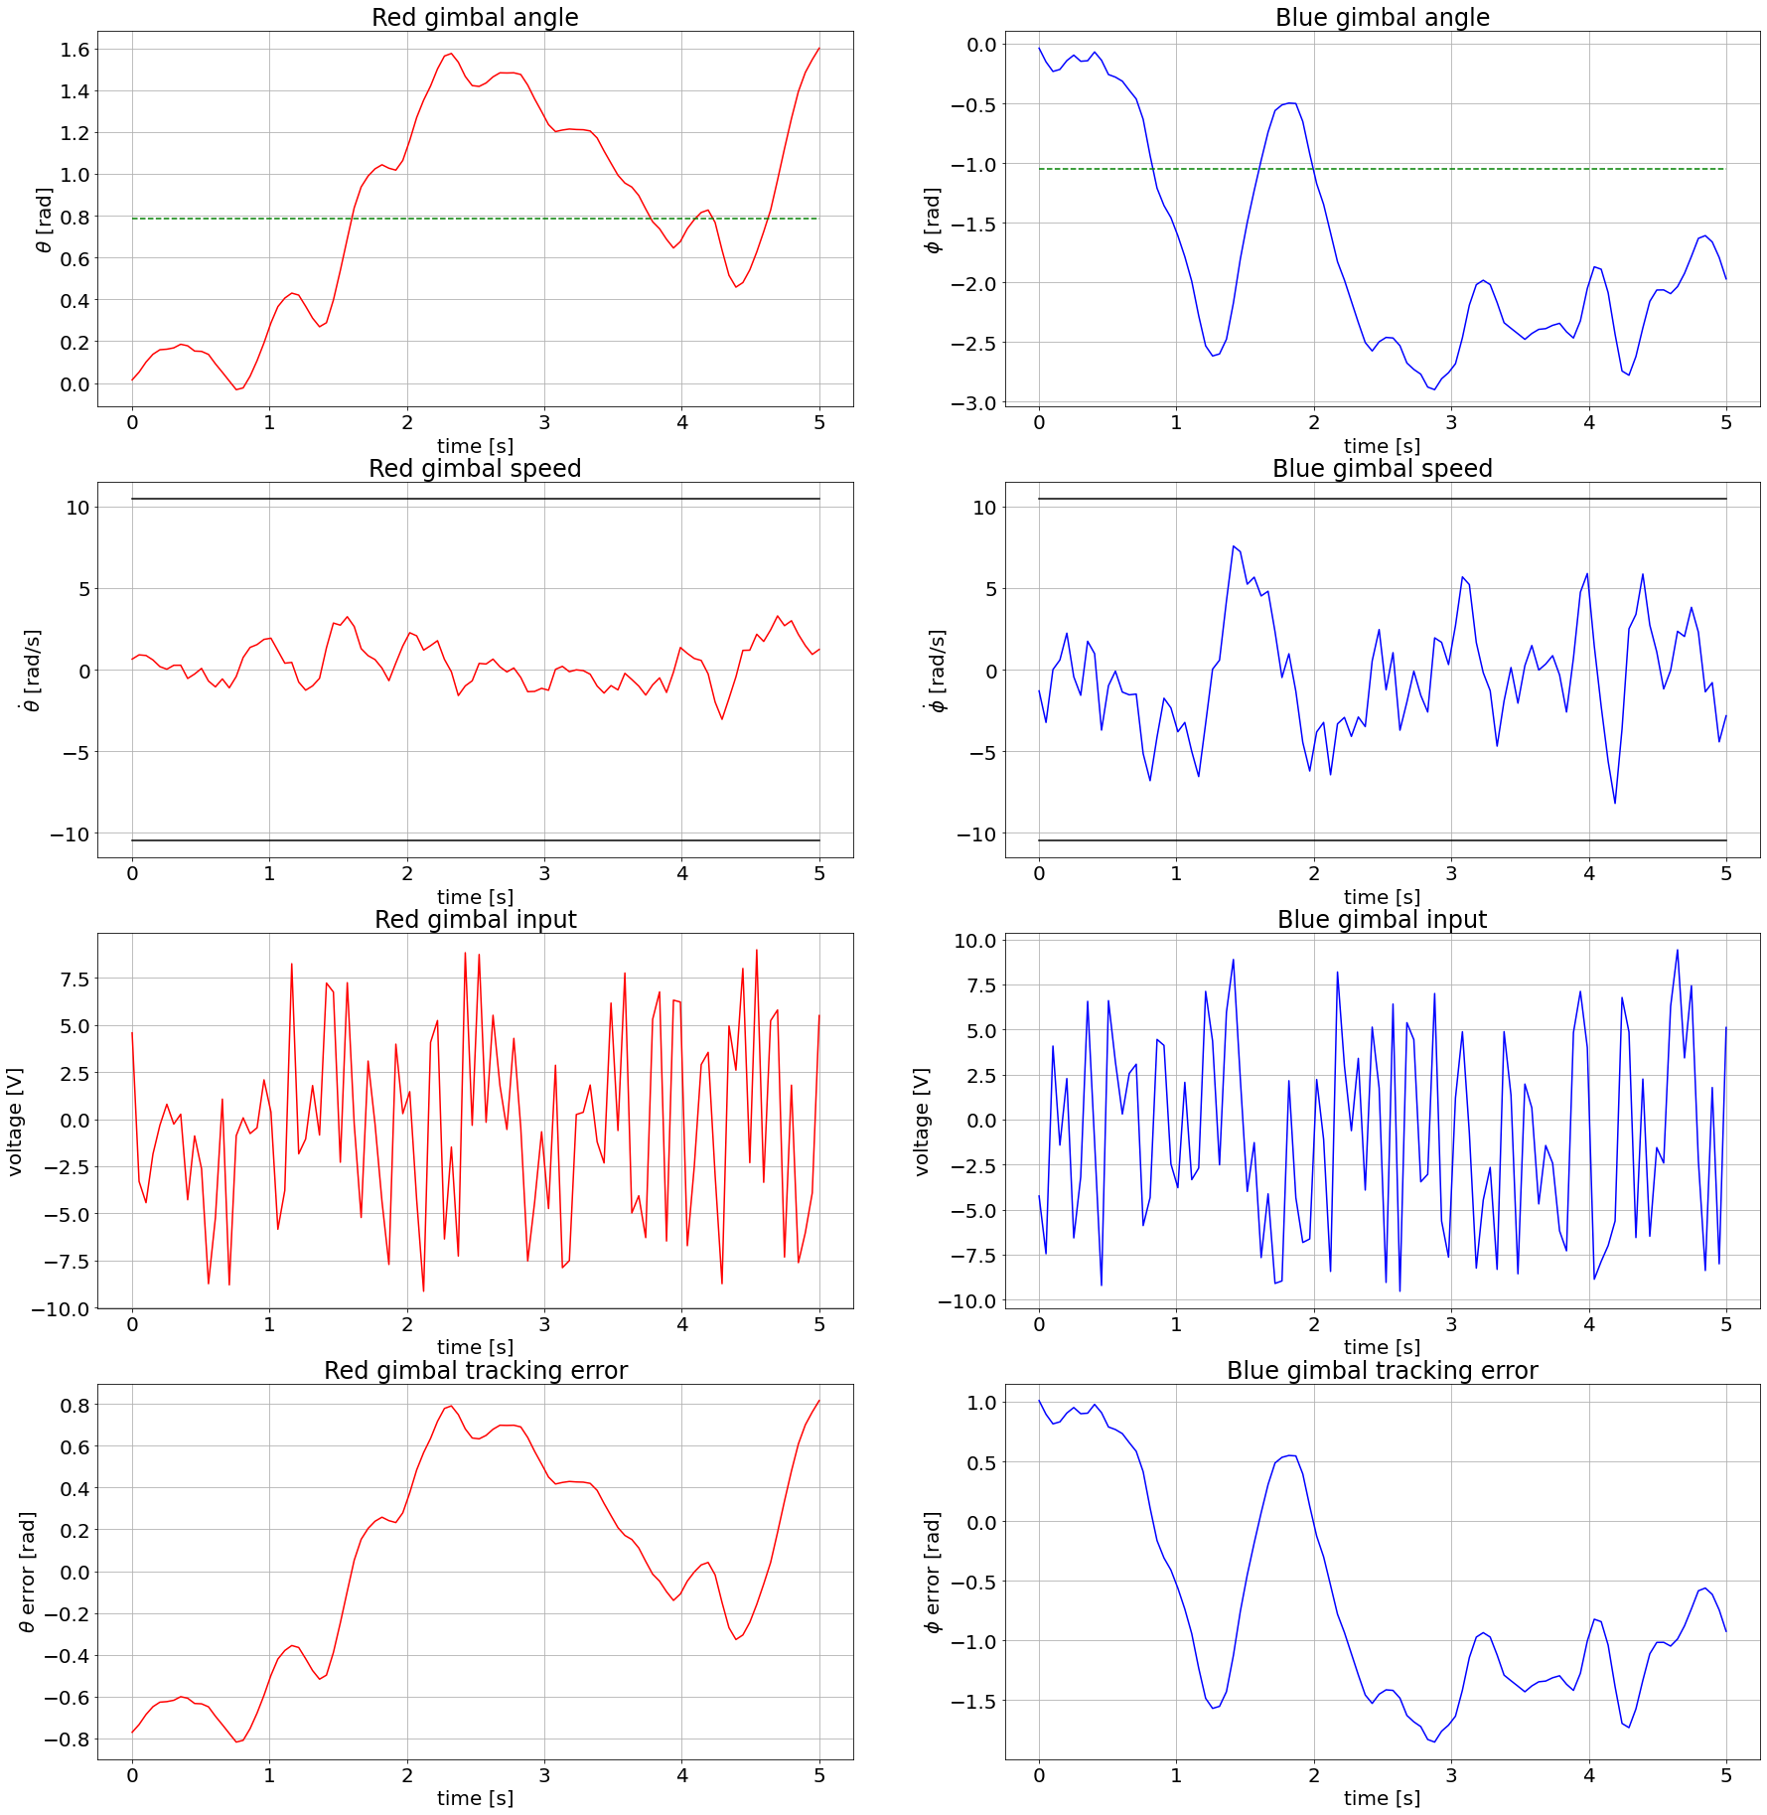
SAC

Slide 34


SAC

Slide 35


SAC

Slide 36


SAC

Slide 37


SAC

Slide 38


SAC

Slide 39


SAC

Slide 40


SAC

Slide 41


SAC

Slide 42


SAC

Slide 43


SAC

Slide 44


SAC

Slide 45


SAC

Slide 46


SAC

Slide 47


SAC

Slide 48


SAC

Slide 49


SAC

Slide 50


SAC

Slide 51


SAC

Slide 52

SAC

Slide 53


SAC

Slide 54

SAC

Slide 55


SAC

Slide 56


SAC

Slide 57


SAC

Slide 58


SAC

Slide 63


DDPG

Slide 64


DDPG

Slide 65


DDPG

Slide 66


DDPG

Slide 67


DDPG

Slide 68


DDPG

Slide 69


DDPG

Slide 70


DDPG

Slide 71


DDPG

Slide 72


DDPG

Slide 73


DDPG

Slide 74


DDPG

Slide 75


DDPG

Slide 76


DDPG

Slide 77


DDPG

Slide 78


DDPG

Slide 79


DDPG

Slide 80


DDPG

Slide 81


DDPG

Slide 82


DDPG

Slide 83


DDPG

Slide 84
DDPG

